Slide 1
PREDICTION AND ANALYSIS OF COMMERCIAL AIRLINE DELAYS BASED ON WEATHER CONDITIONS
ECE 180: Programing for Data Analysis
March 15th, 2018

Slide 2
TEAM 15
Hsiao-Chen Huang
Zi Deng
Ruixian Liu
Hannah Valenzuela
Junhao Su
Notes:
Was thinking of adding our pictu

Slide 3
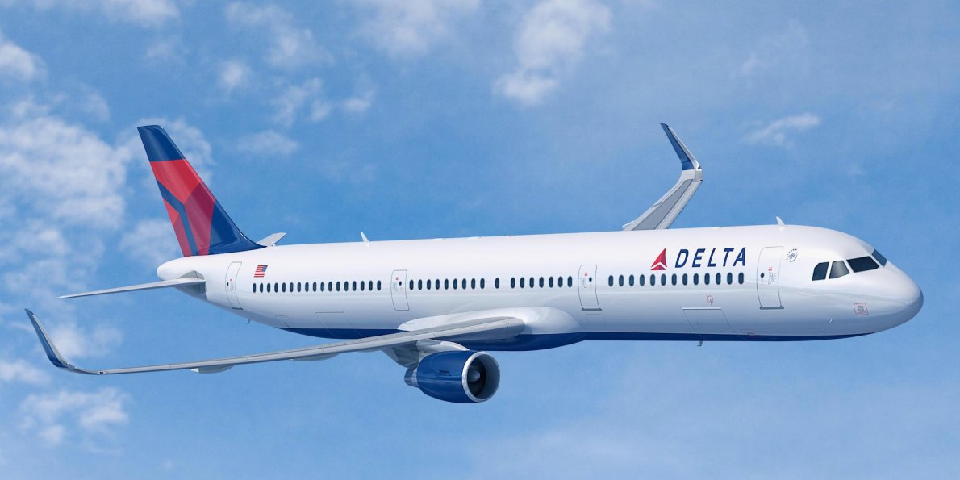
MOTIVATIONS
WHY ARE FLIGHT DELAYS A PROBLEM?
There is an average of 42,700 commercial aircraft flights happening every day.
It is detrimental to have your flight delayed.
Flight Delays cost the US Economy roughly $30 billion every year.
There’s no recovering lost time.
WHAT CAN WE DO ABOUT IT?
Analyze data about flight delays to find:
How often are flights delayed?
When are flights delayed the most?
What is the most common cause of delays?
Use weather(a predictable variable) to estimate future flight delays.
Inform customers about the best time to schedule flights.
Notes:
Worlds is interconnected, more people fly on airplanes than ever before.
$8 Billion is a direct cost to airlines, 17 Billion is a cost to passengers and the remanding forgone in GDP

Slide 4
PROCESS
FLIGHTS
WEATHER
Get Flight Data
Get Weather Data Through Web Scraping
Establish Flight vs Weather Relationship
Analyze Flight Data
Visualize and Plot Combined Data
Predict Future Delays

Slide 5

PACKAGES
Pandas: Data structures and data analysis tools
Numpy: N-dimensional array and broadcasting
Matplotlib: Data plotting and visualization
Time: Dates, hours, minutes, etc
Re: String and character matching
Urllib2: Opening URLs and using Internet resources
BeautifulSoup: Web Scraping.
Notes:
Gotta add more stuff Urllib2, BeautifulSoup but I don;t understand those very well.

Slide 6
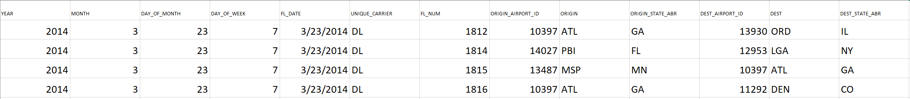
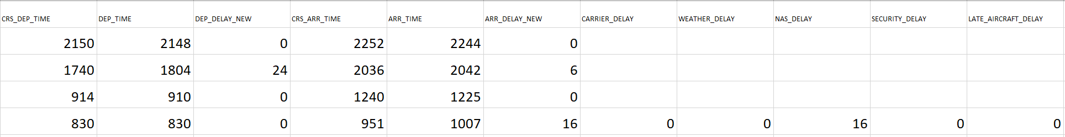
FLIGHT DATA
Our flight data is pulled from the Bureau of Transportation website. It is publically available and provides very accurate and up to date data on on time performance for all major airlines in the US.
Notes:
Data set is by flight by flight basis and separated by months

Slide 7
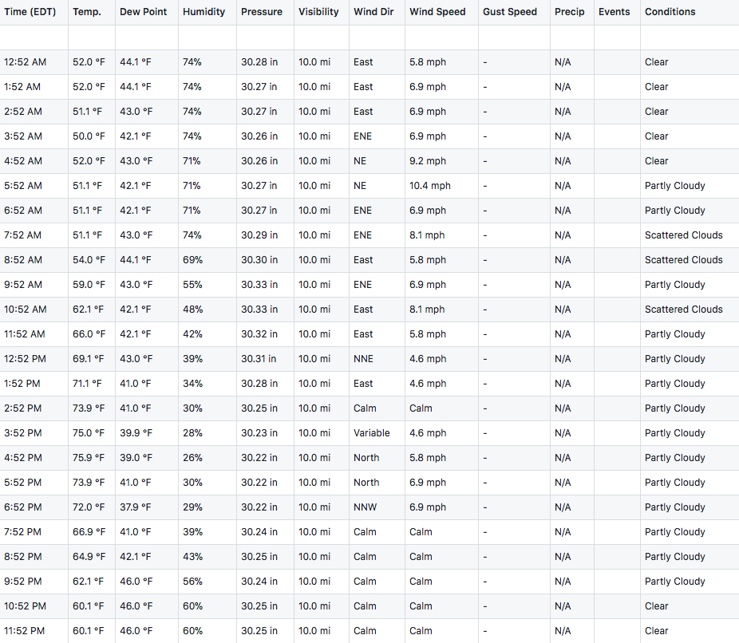
WEATHER DATA
Our weather data is web scraped from the site Weather Underground. It provides hourly weather conditions of a specified location for the past 5 years and for the upcoming week.
Web scraping is done using the python tool BeautifulSoup.
Notes:
Data set is by flight by flight basis and separated by months.
Web scraping is done from a tutorial of

Slide 8
FLIGHT DATA ANALYSIS
1
A Visualization of Various Delays In 2017
Notes:
We only look at one specific year 2017.

Slide 9
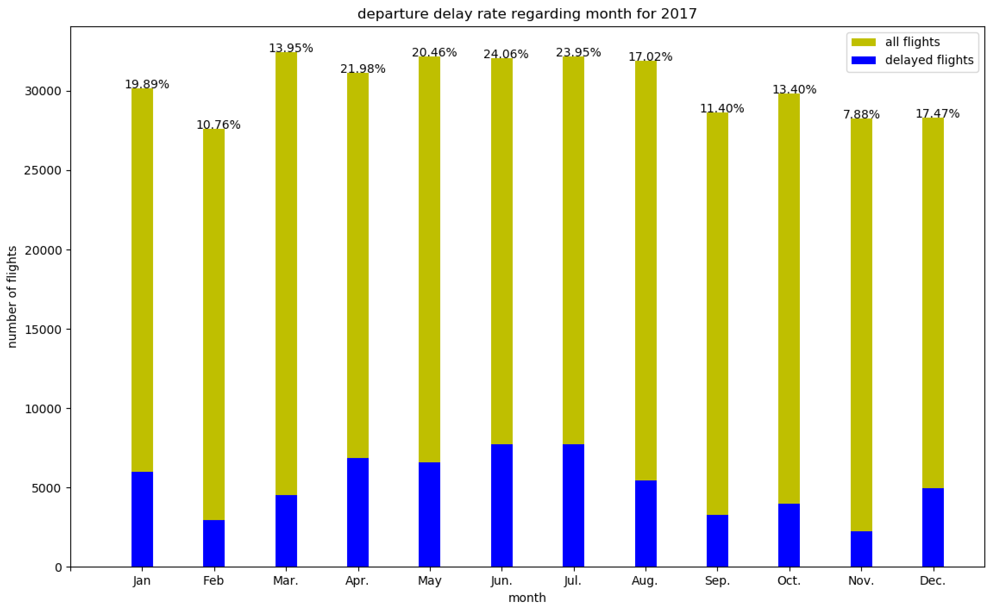
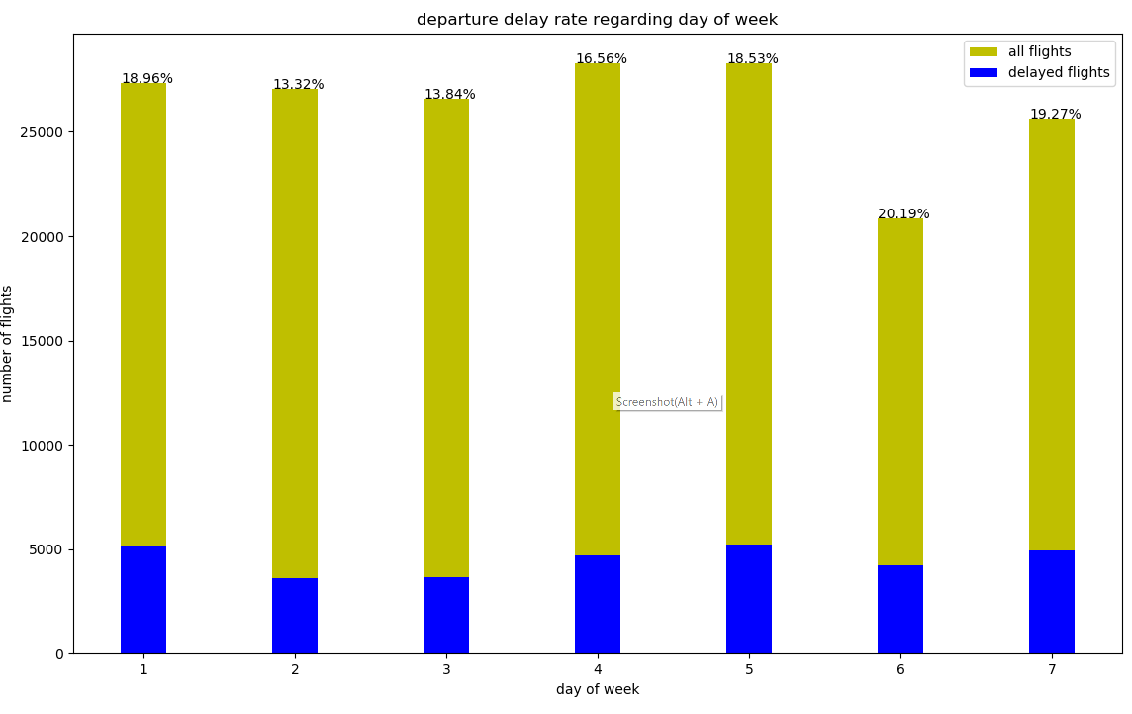
DEPARTURE DELAY ANALYSIS
Individual days had a weak effect on departure delay rates.
Highest: Friday - 20.19% delayed, Lowest: Monday - 13.32% delayed
Specific months had larger effect delay rates, with a max difference of 13.3%
Highest: June - 24.06% delayed, Lowest: February - 10.76%
Notes:
Many causes like more Fridays flights could have higher volume because it’s the start of the weekend, while Monday is the start of the week.
June is when summer break begins, no particular big holidays in February.
Not enough data to confirm, but we can make a valid hypothesis.

Slide 10
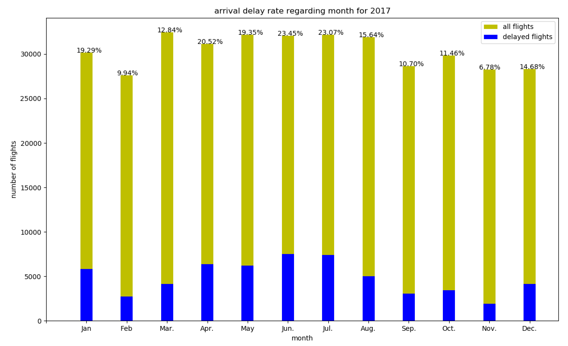
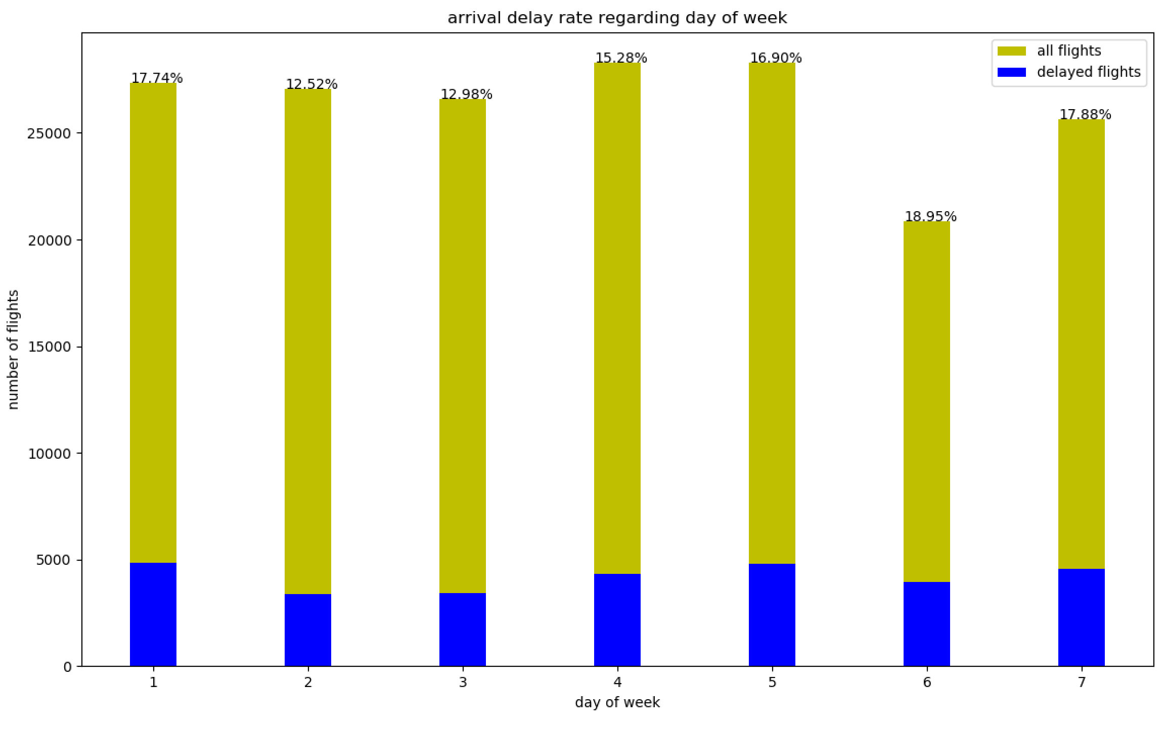
ARRIVAL DELAY ANALYSIS
Arrival delays follow the exact same trend as departure, as well as the same min/max.
Highest Day: Friday - 18.95% delayed, Lowest Day: Monday - 12.52% delayed
Highest Month: June - 23.45% delayed, Lowest Month: February - 9.94%
Interestingly, there are overall less delays in arrival than departure, suggesting that pilots can in fact make up loss time in the air
Notes:
Many causes like more Fridays flights could have higher volume because it’s the start of the weekend, while Monday is the start of the week.
June is when summer break begins, no particular big holidays in February.
Not enough data to confirm, but we can make a valid hypothesis.

Slide 11
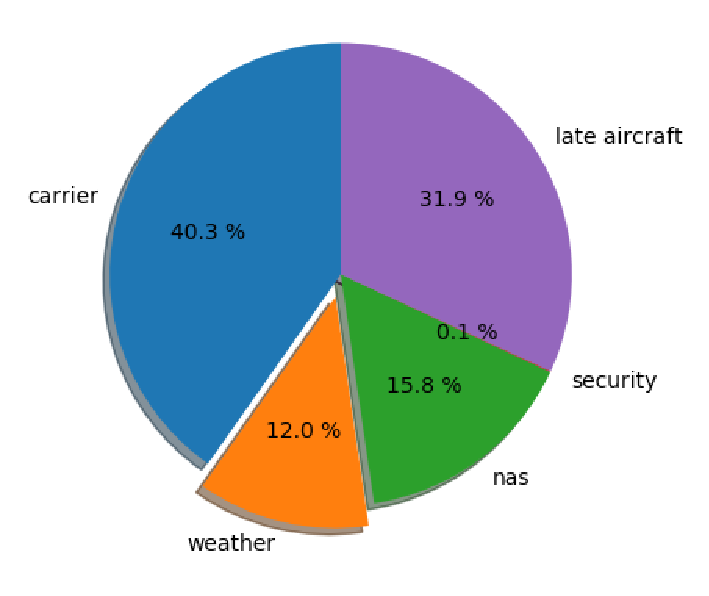
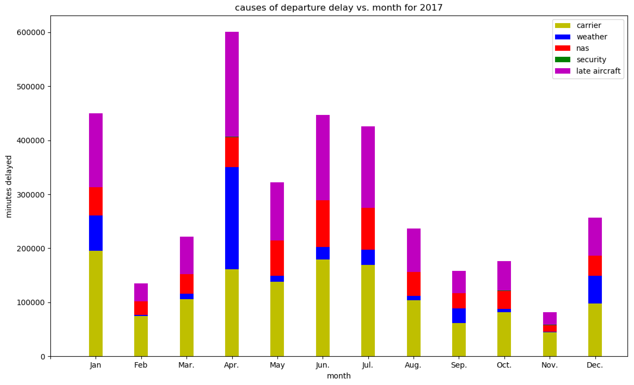
CAUSES OF DELAYS
Turns out the most common reason for flight delays is not weather, but actually air carrier issues.
In general, airline issues include aircraft maintenance, crew scheduling, refueling, etc.
However, weather is the only variable where it is possible to get future data.

Slide 12
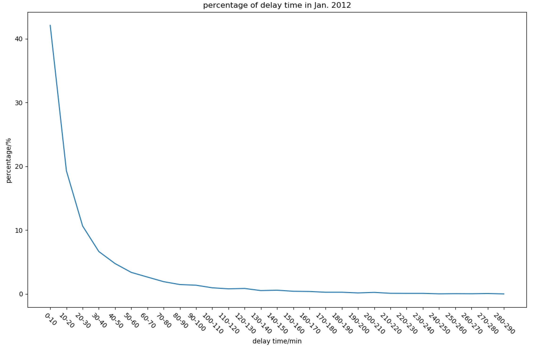
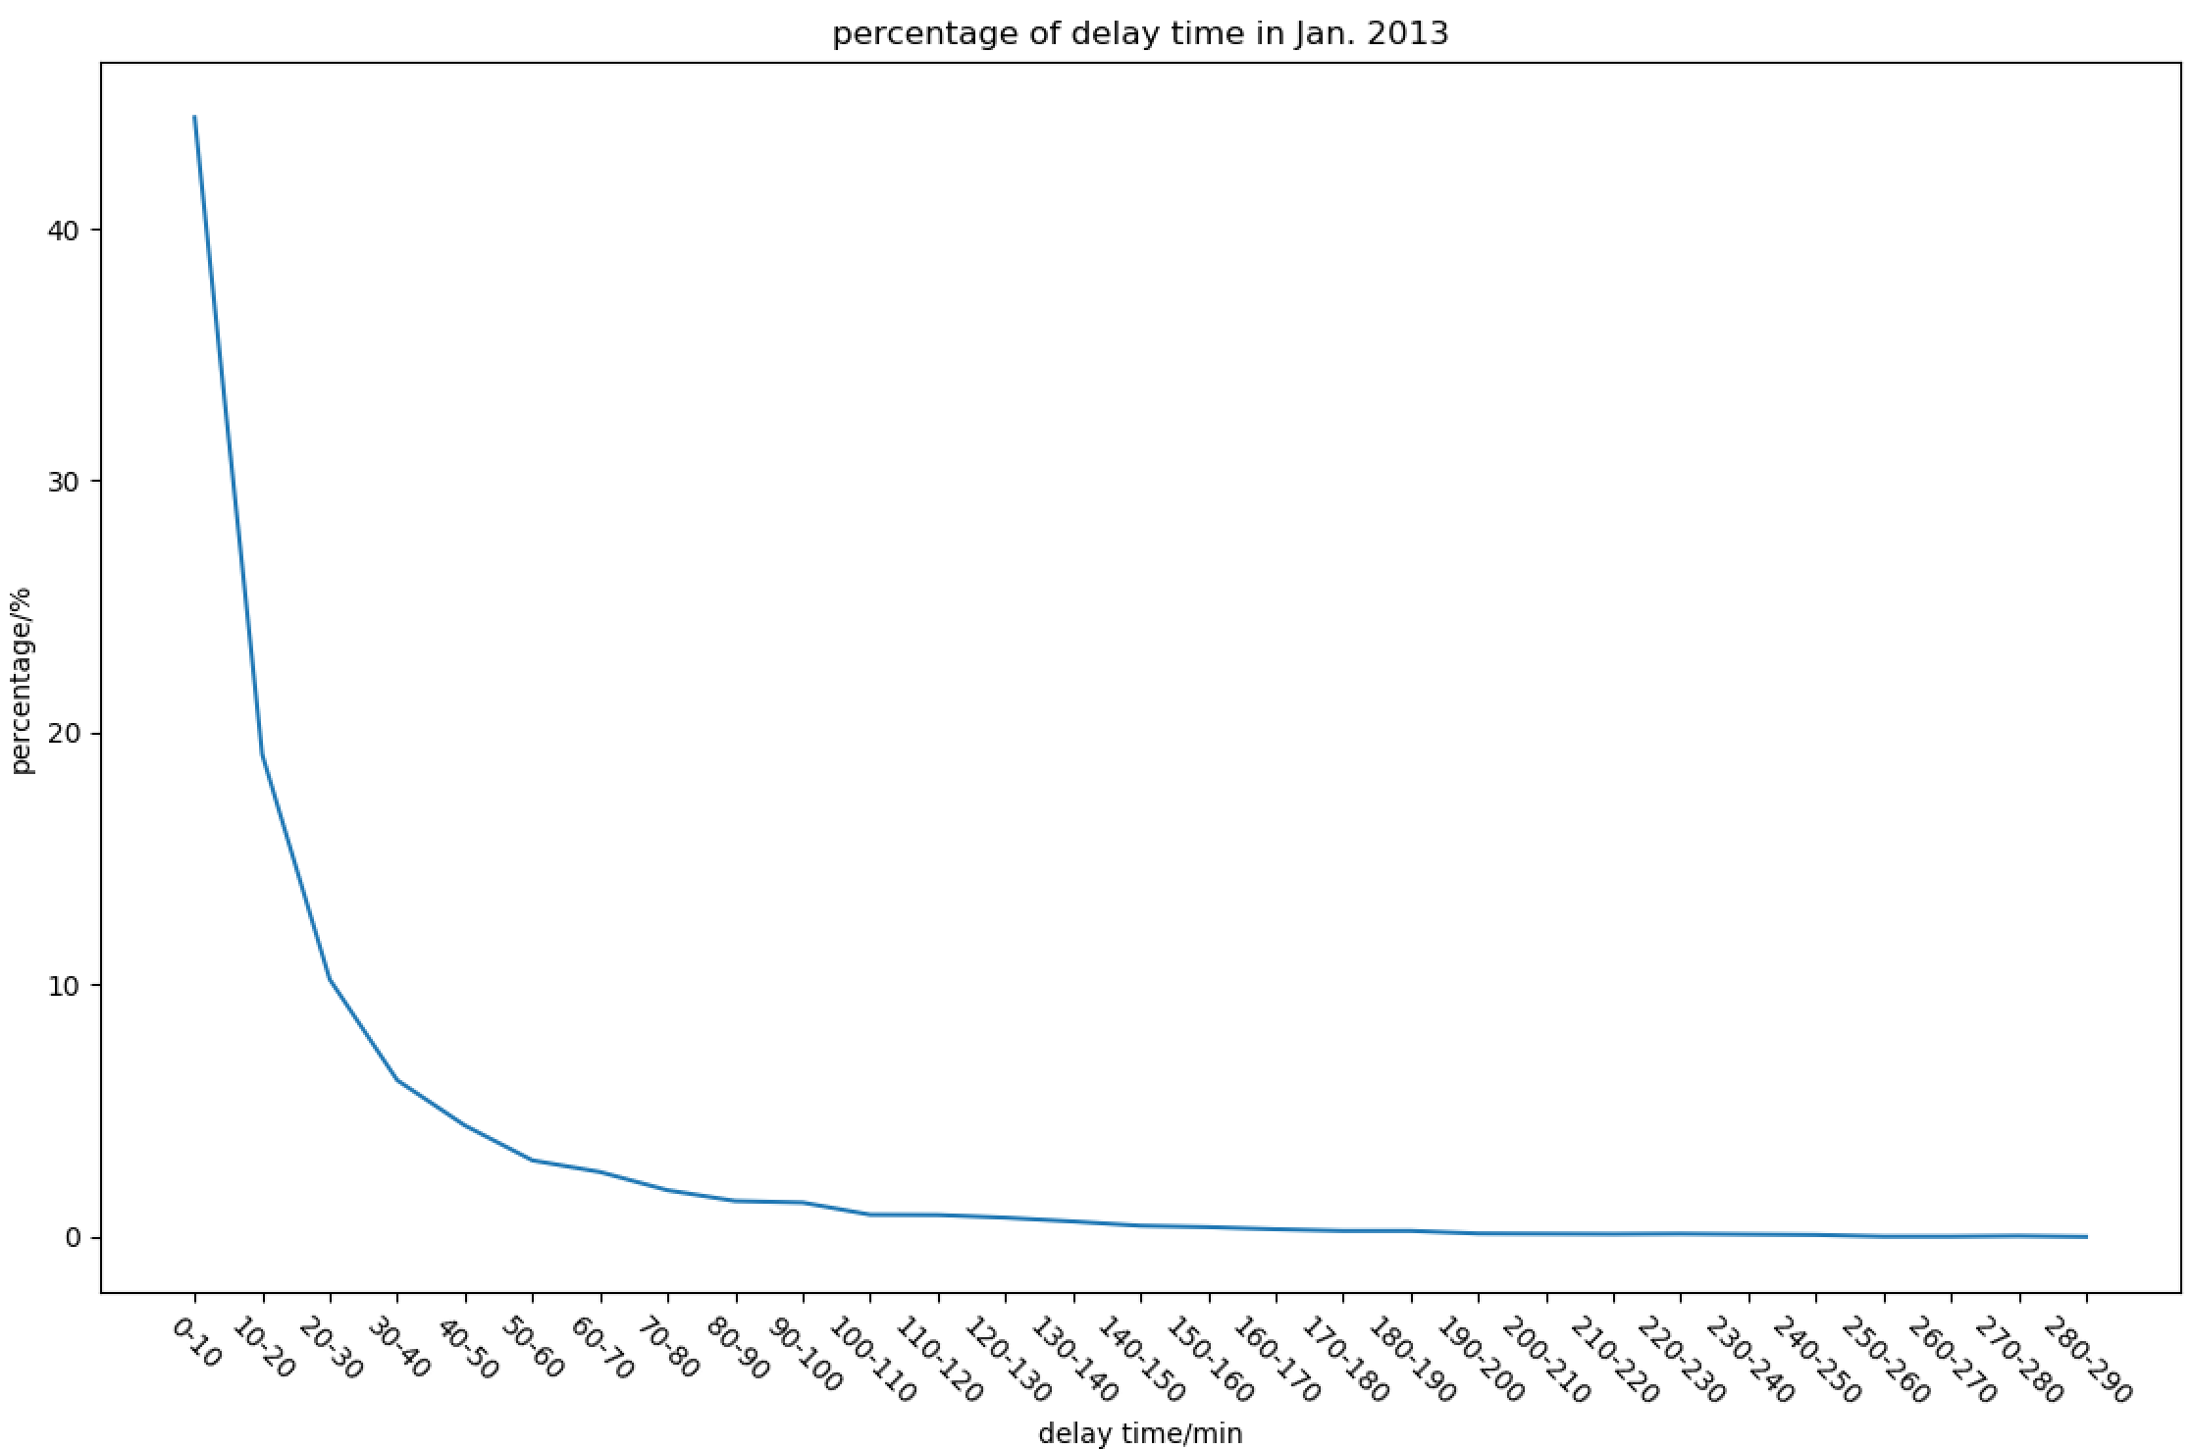
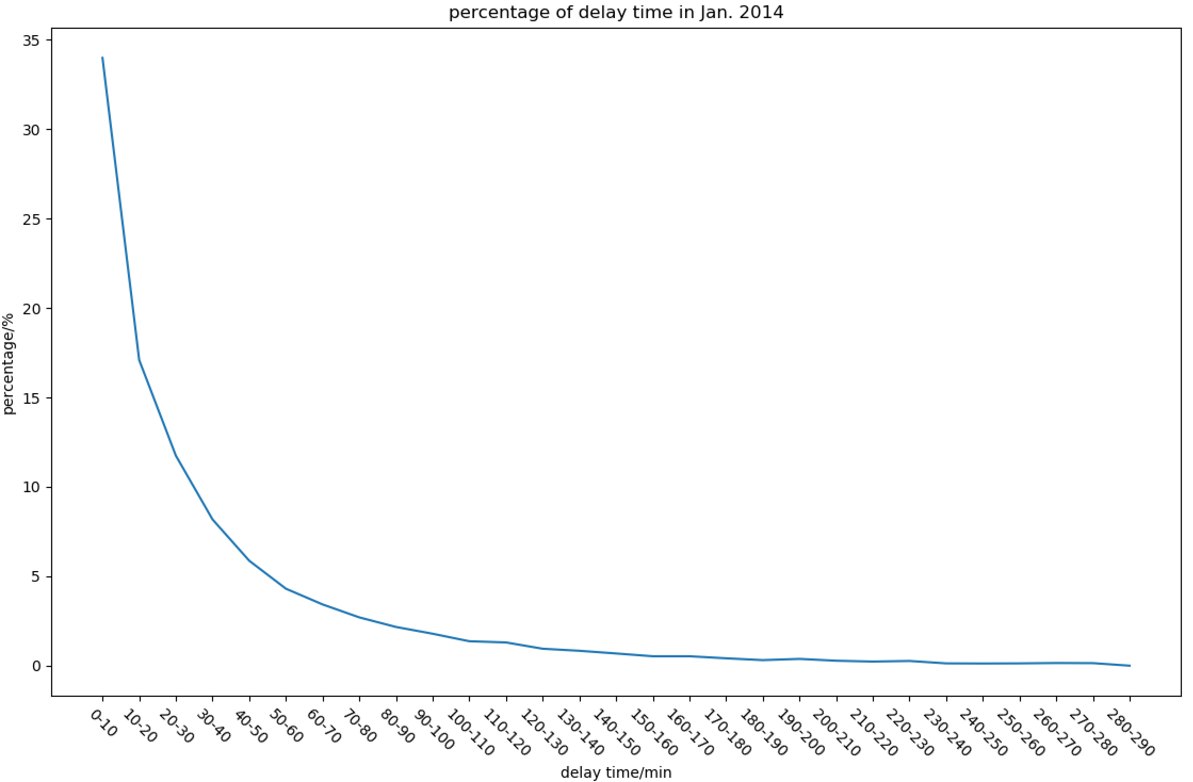
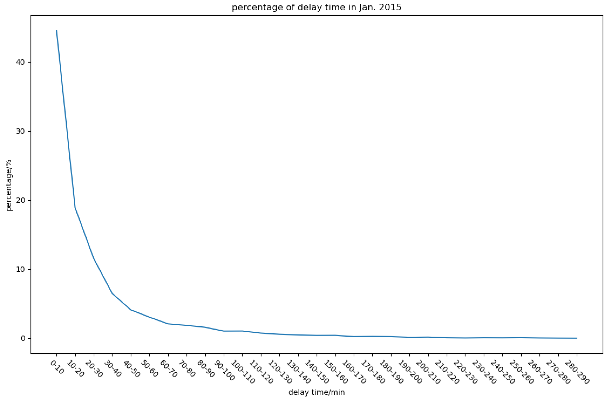
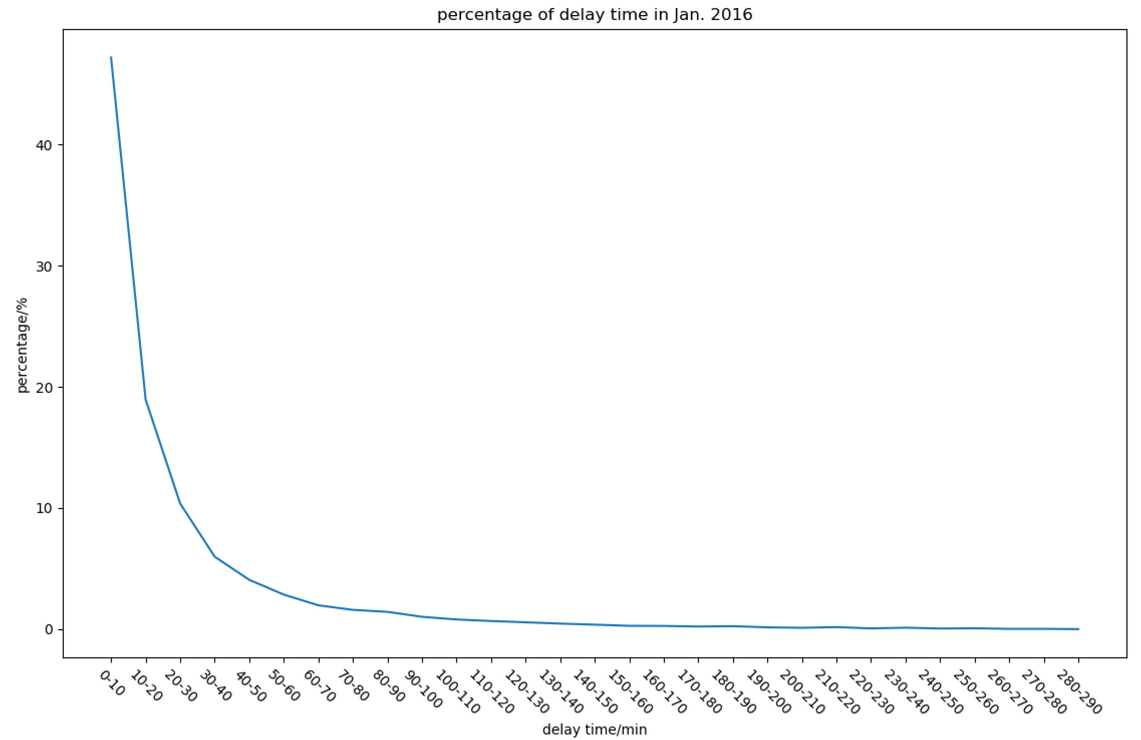
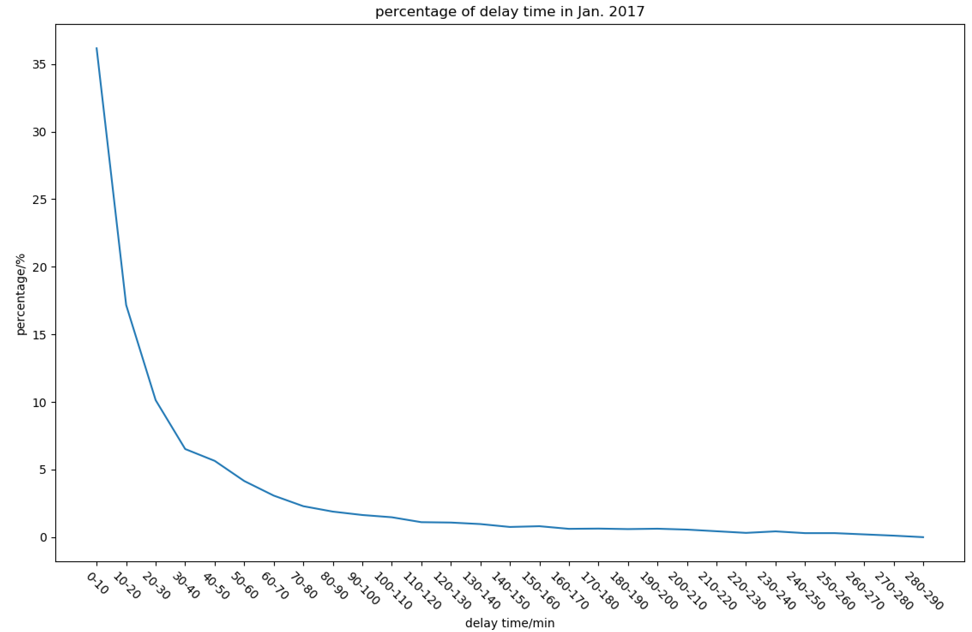
YEAR BY YEAR ANALYSIS
For the past five years, the trend for flight delay percentages has been roughly the same.
2014 appears to have had the most overall delays while 2016 had the lowest amount of delays.

Slide 13
WEATHER VERSUS DELAY
2
Finding the Relationship of Flight and Weather
Notes:
We only look at one specific year 2017.

Slide 14
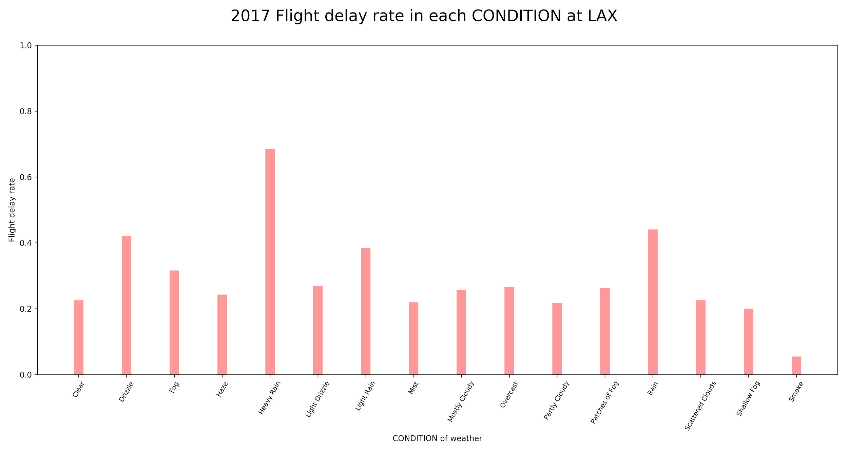
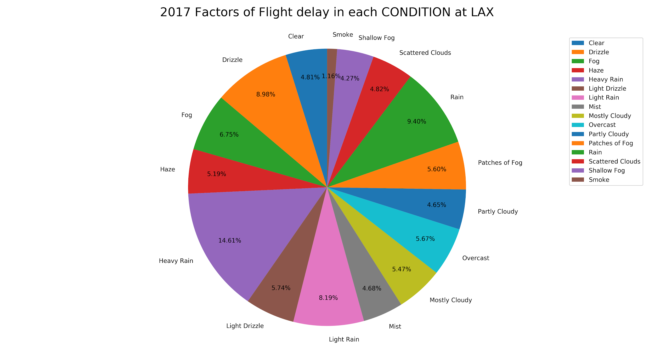
WEATHER CONDITION VERSUS DELAY
We look at the weather data of various cities and categorize them into distinct conditions to establish a relationship.
Here is the analysis of the Los Angeles International Airport in California.
It’s clear to see that the worse the weather is, the more like there is a flight delay.
In heavy rain condition, LAX had a whopping 70% flight delay rate.

Slide 15
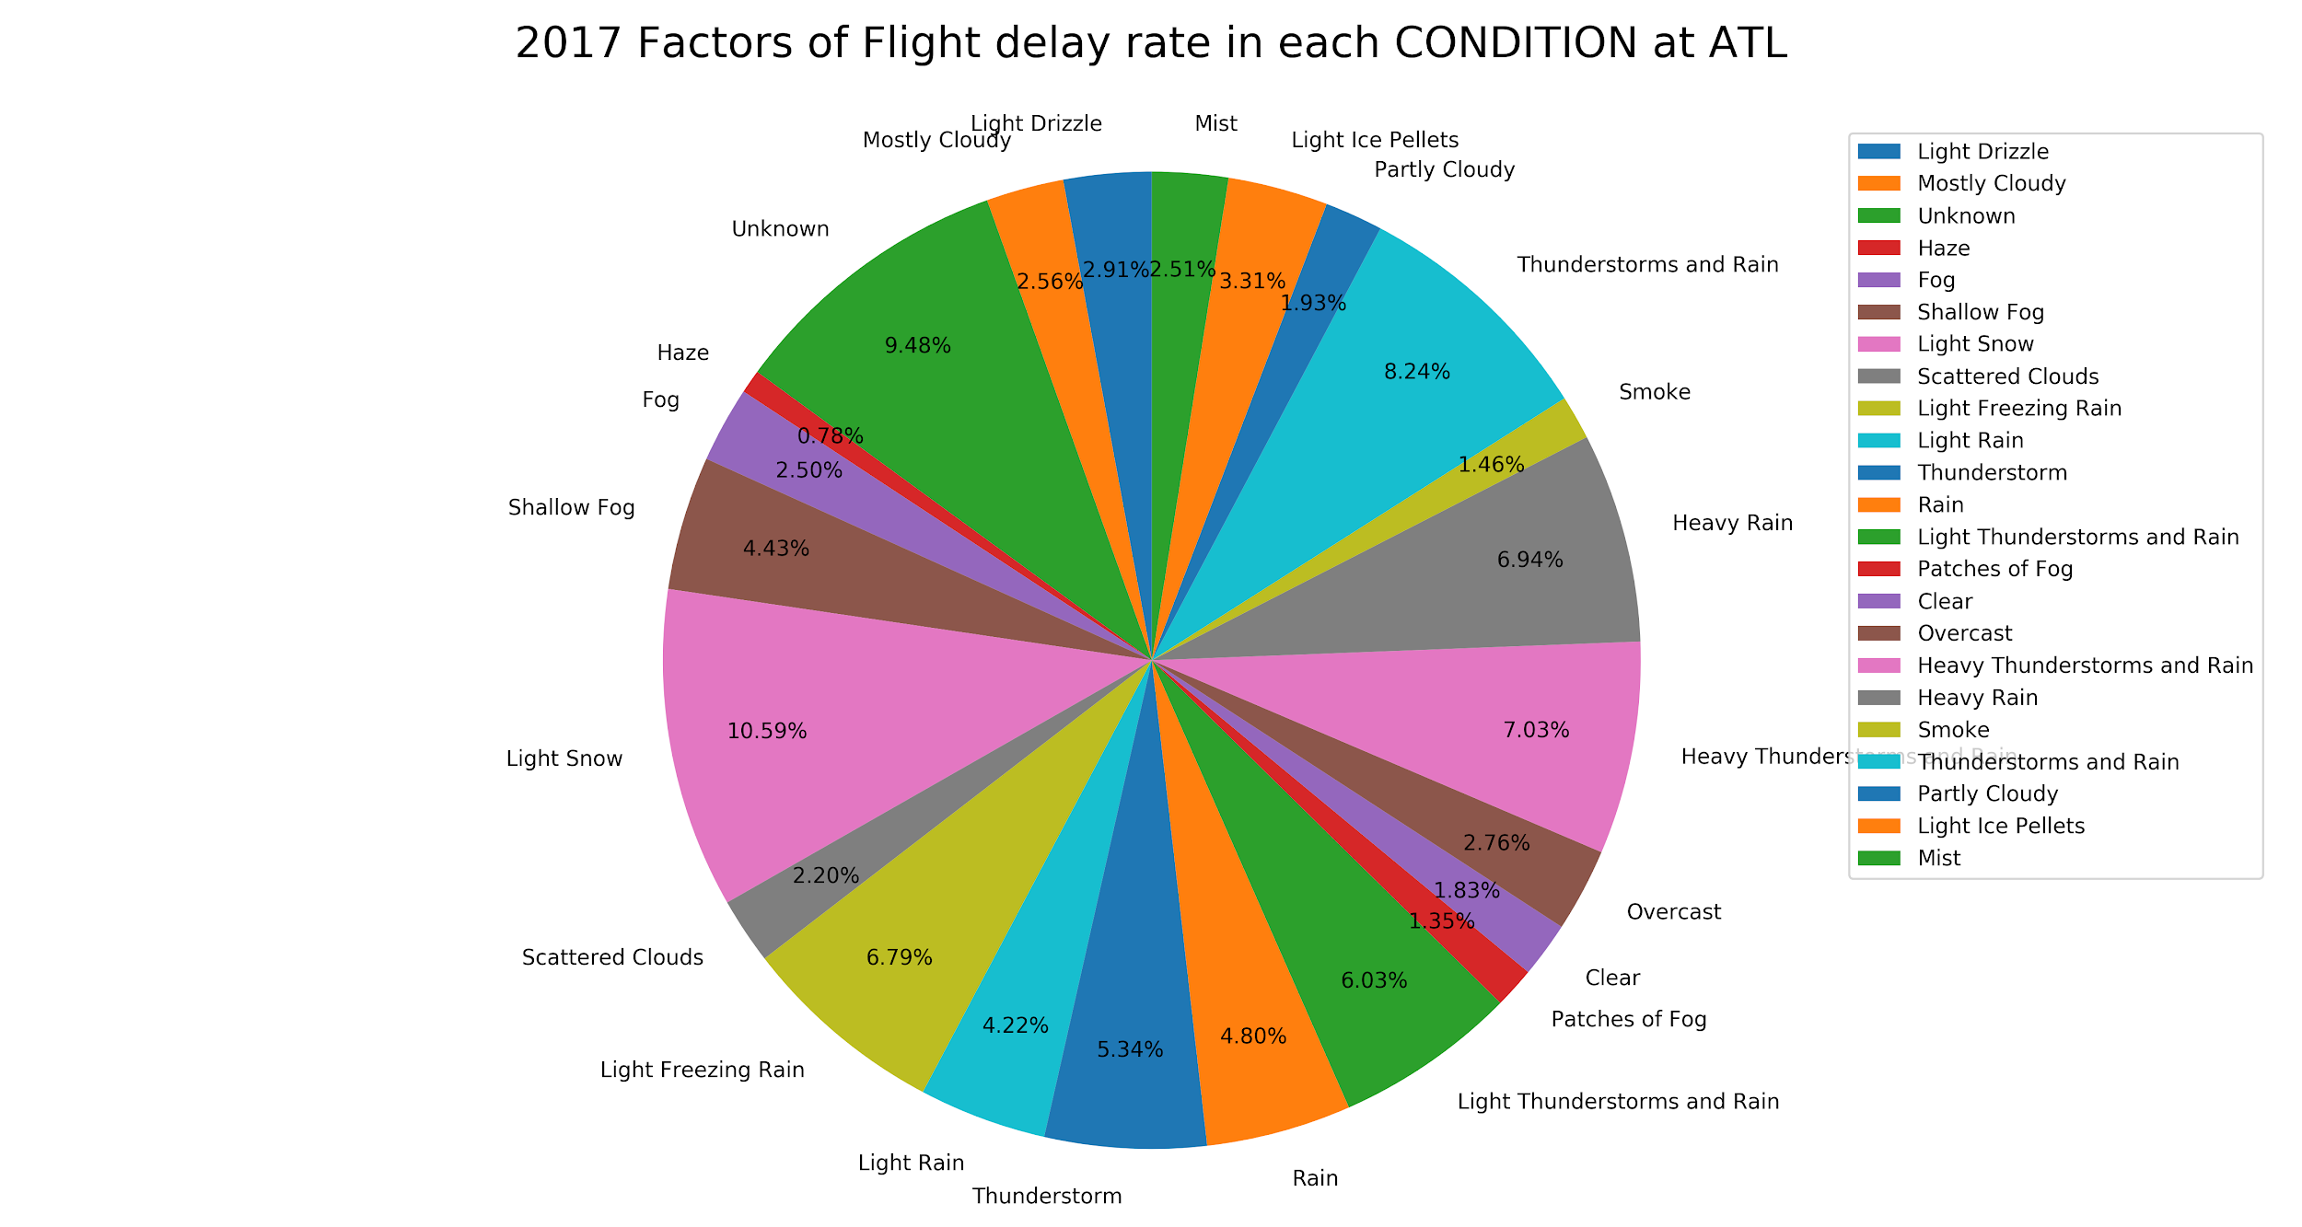
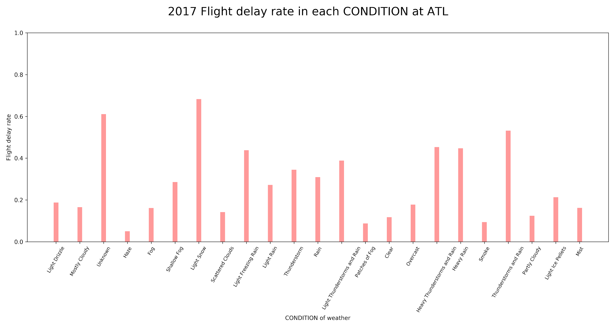
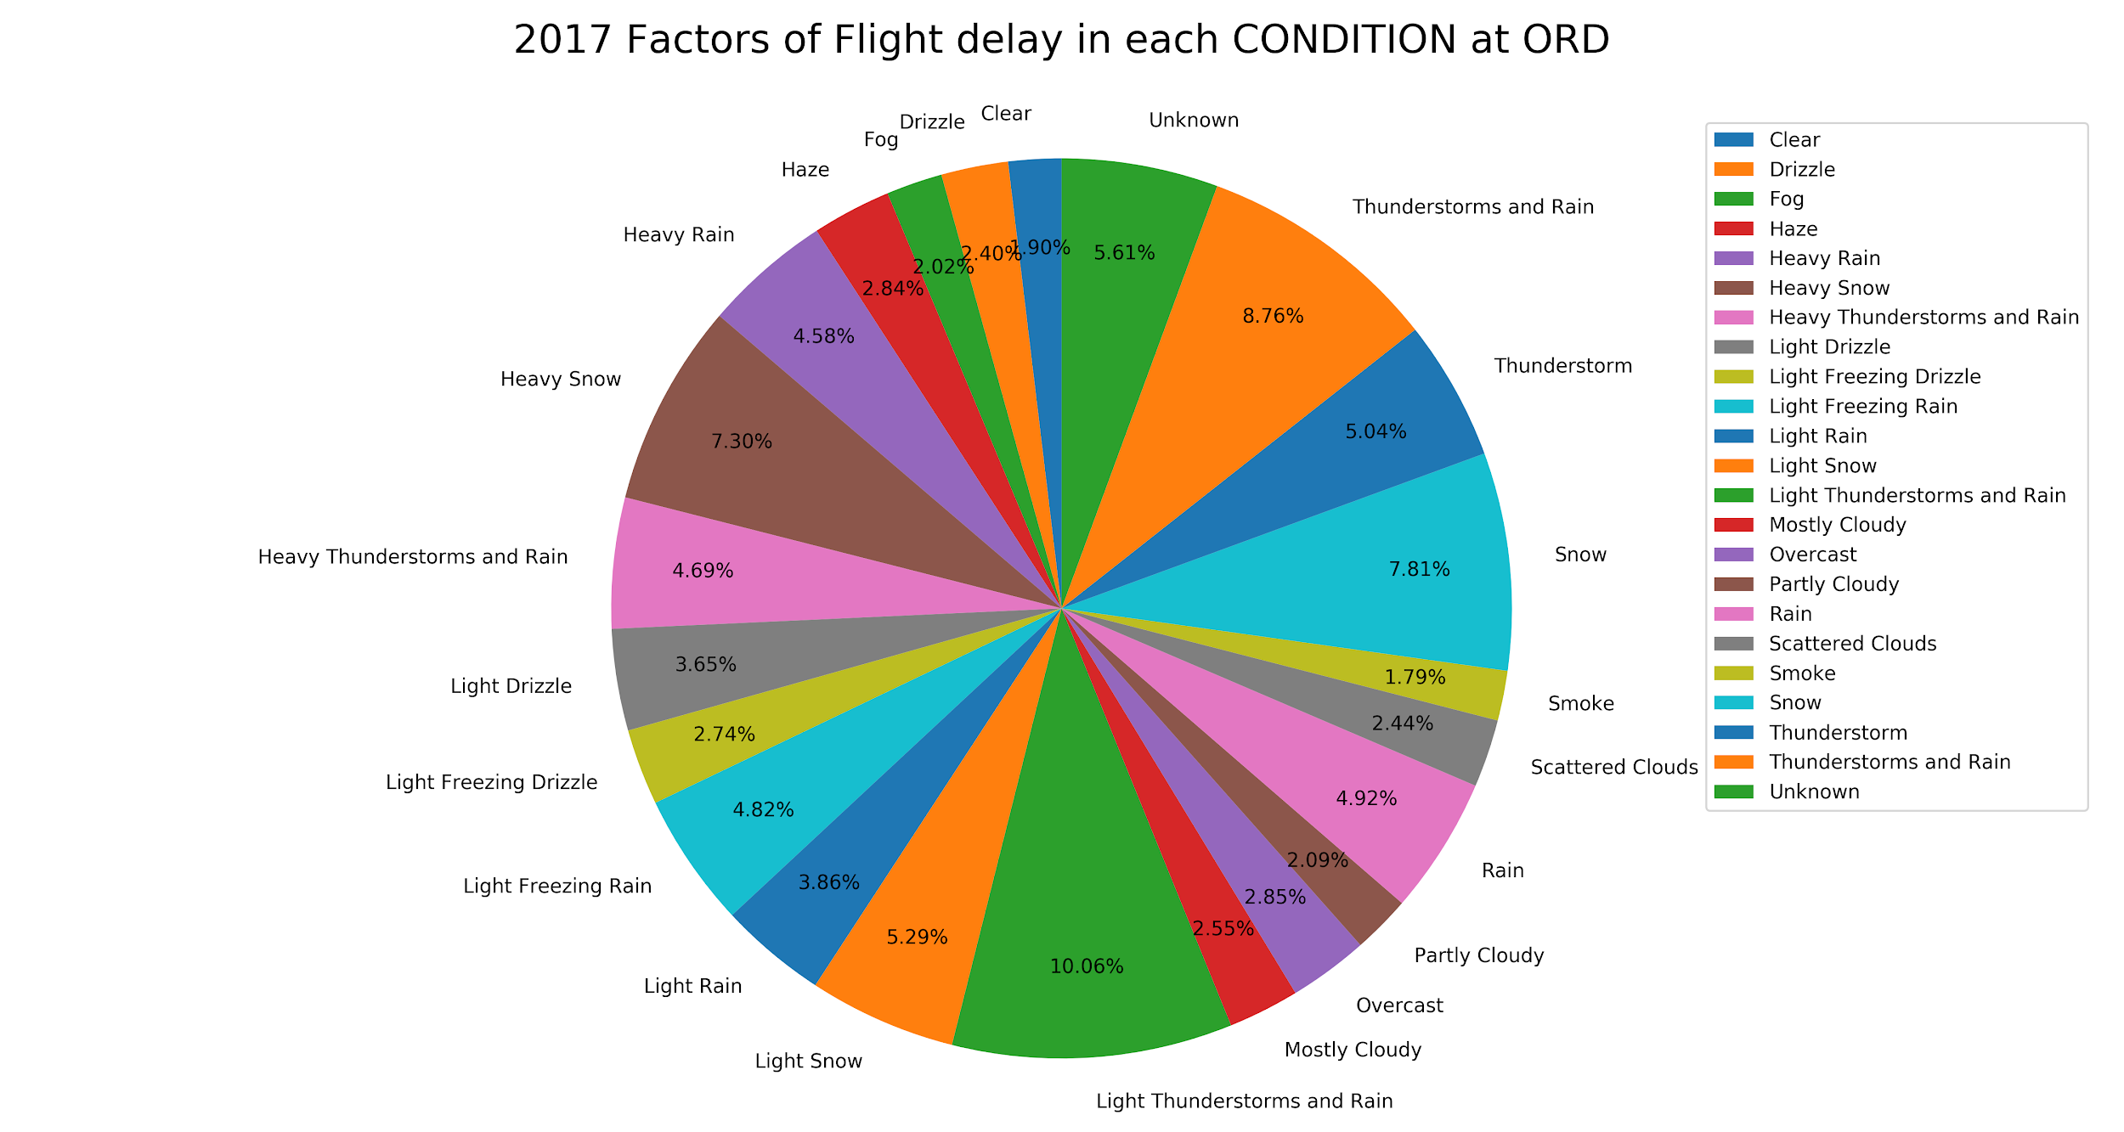
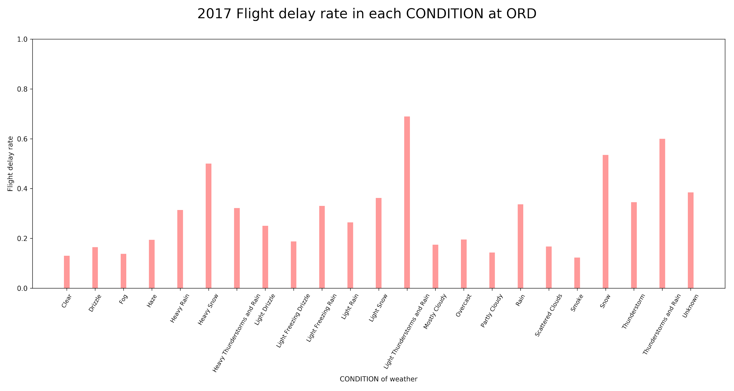
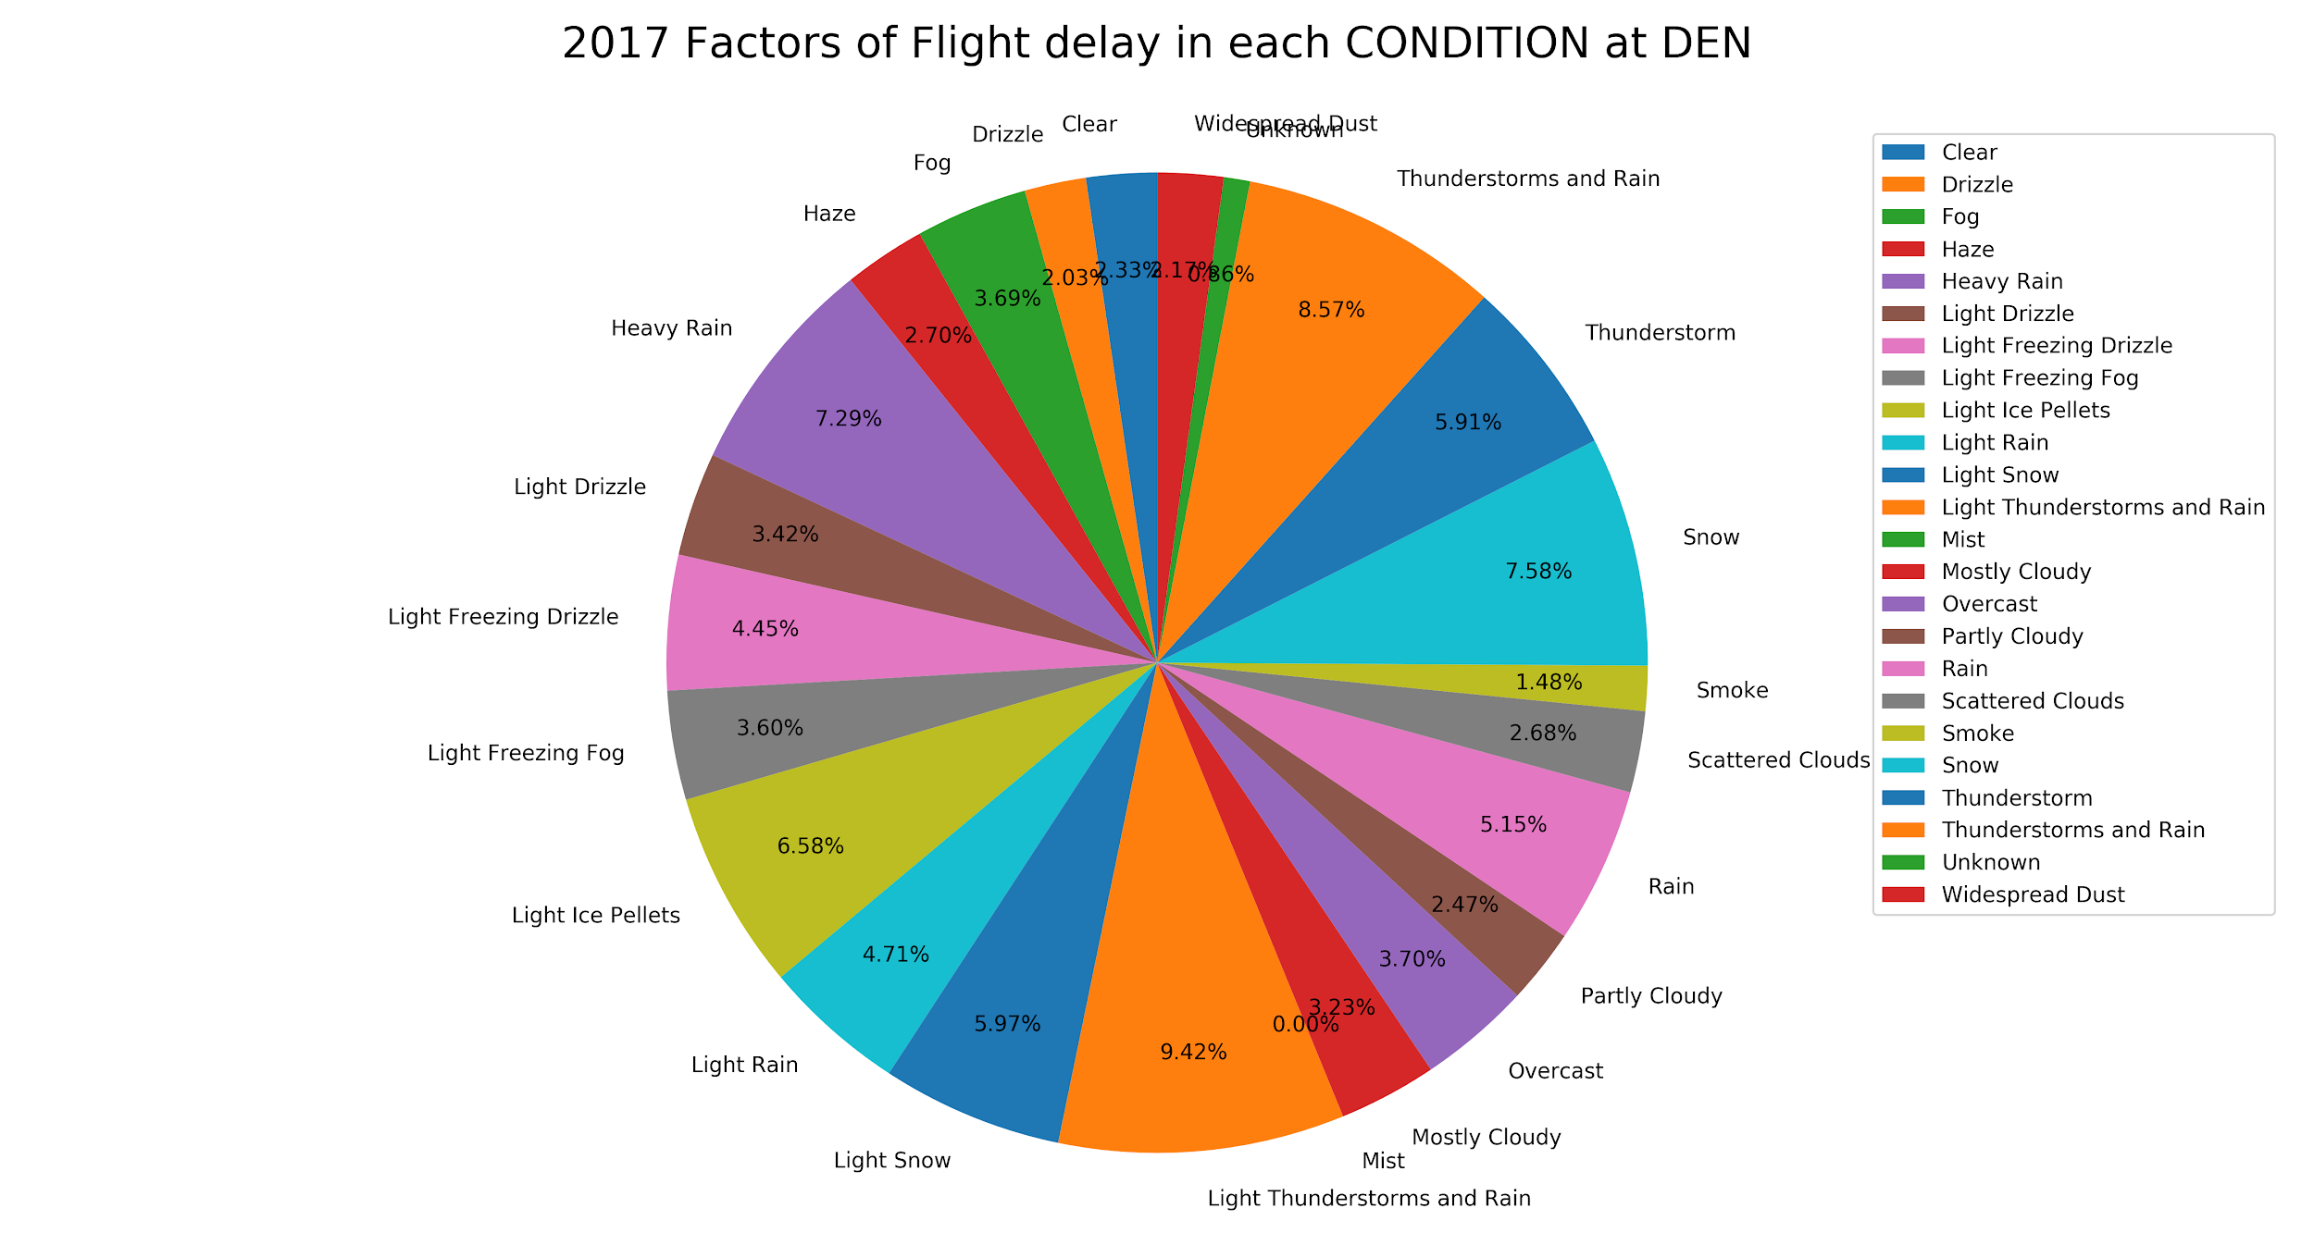
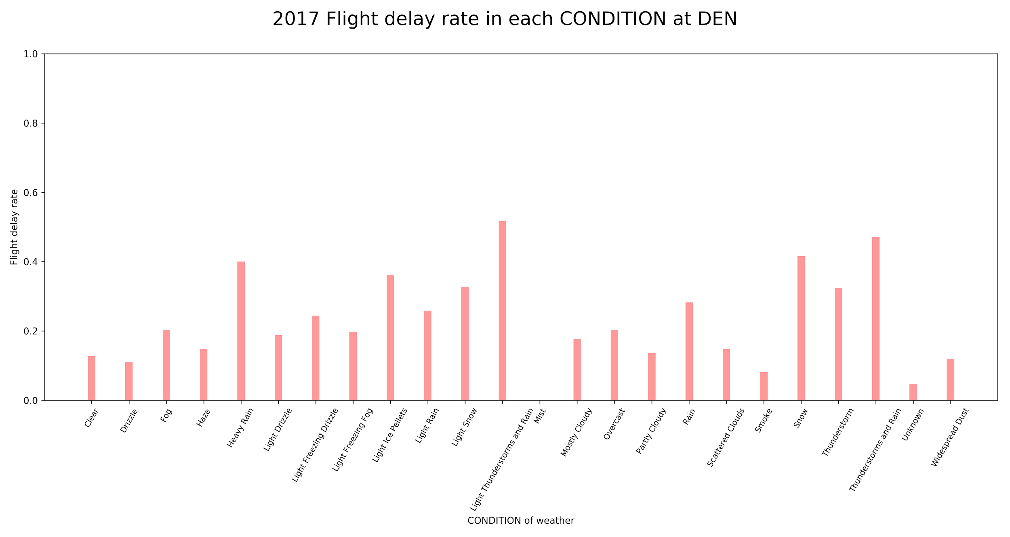
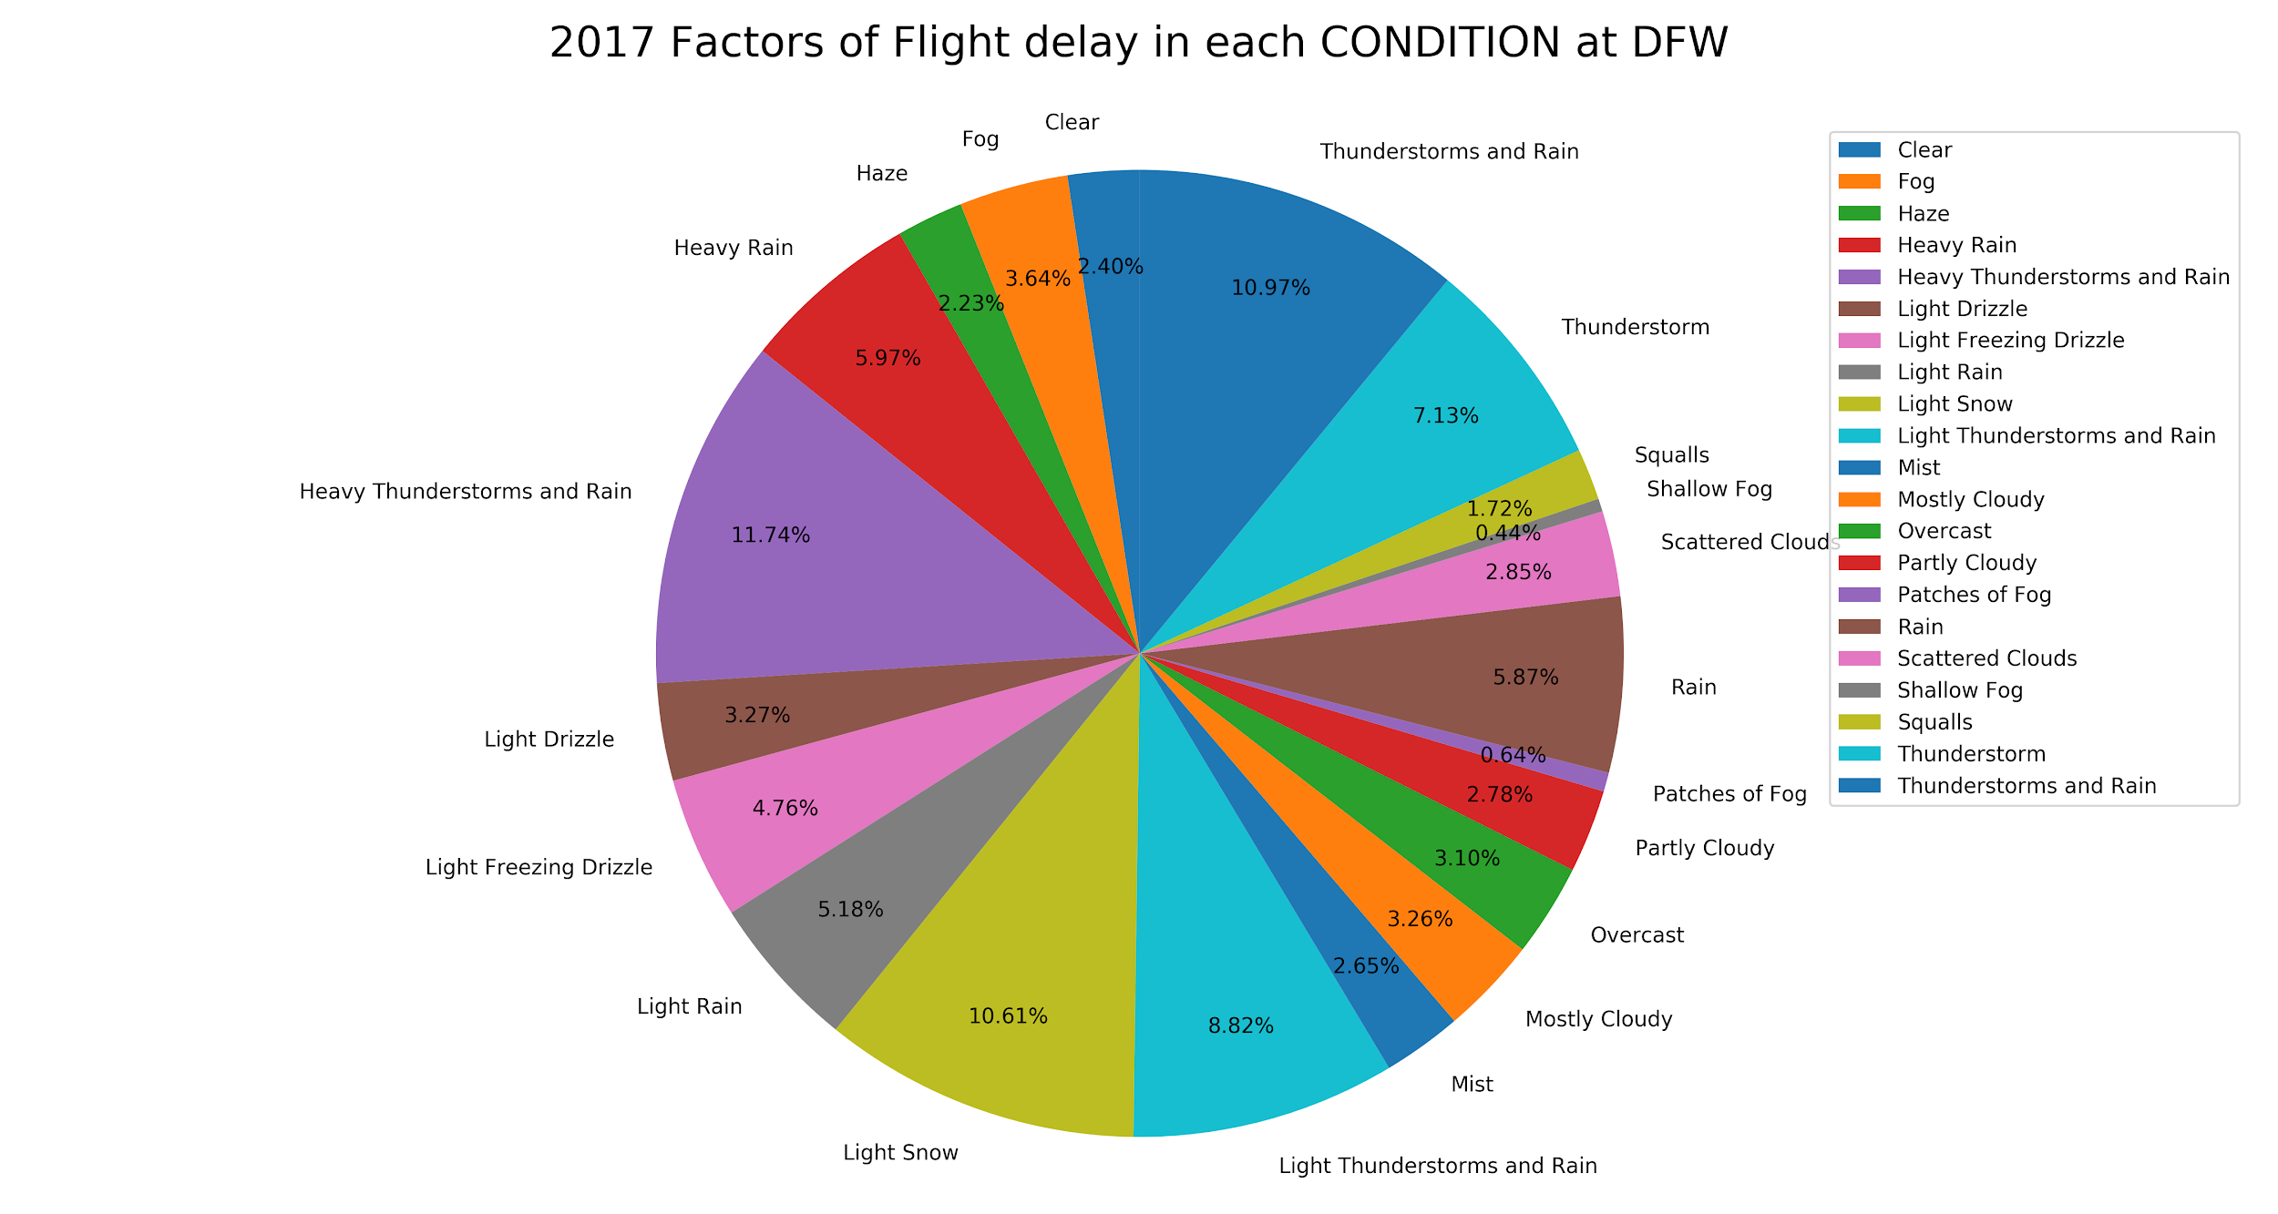
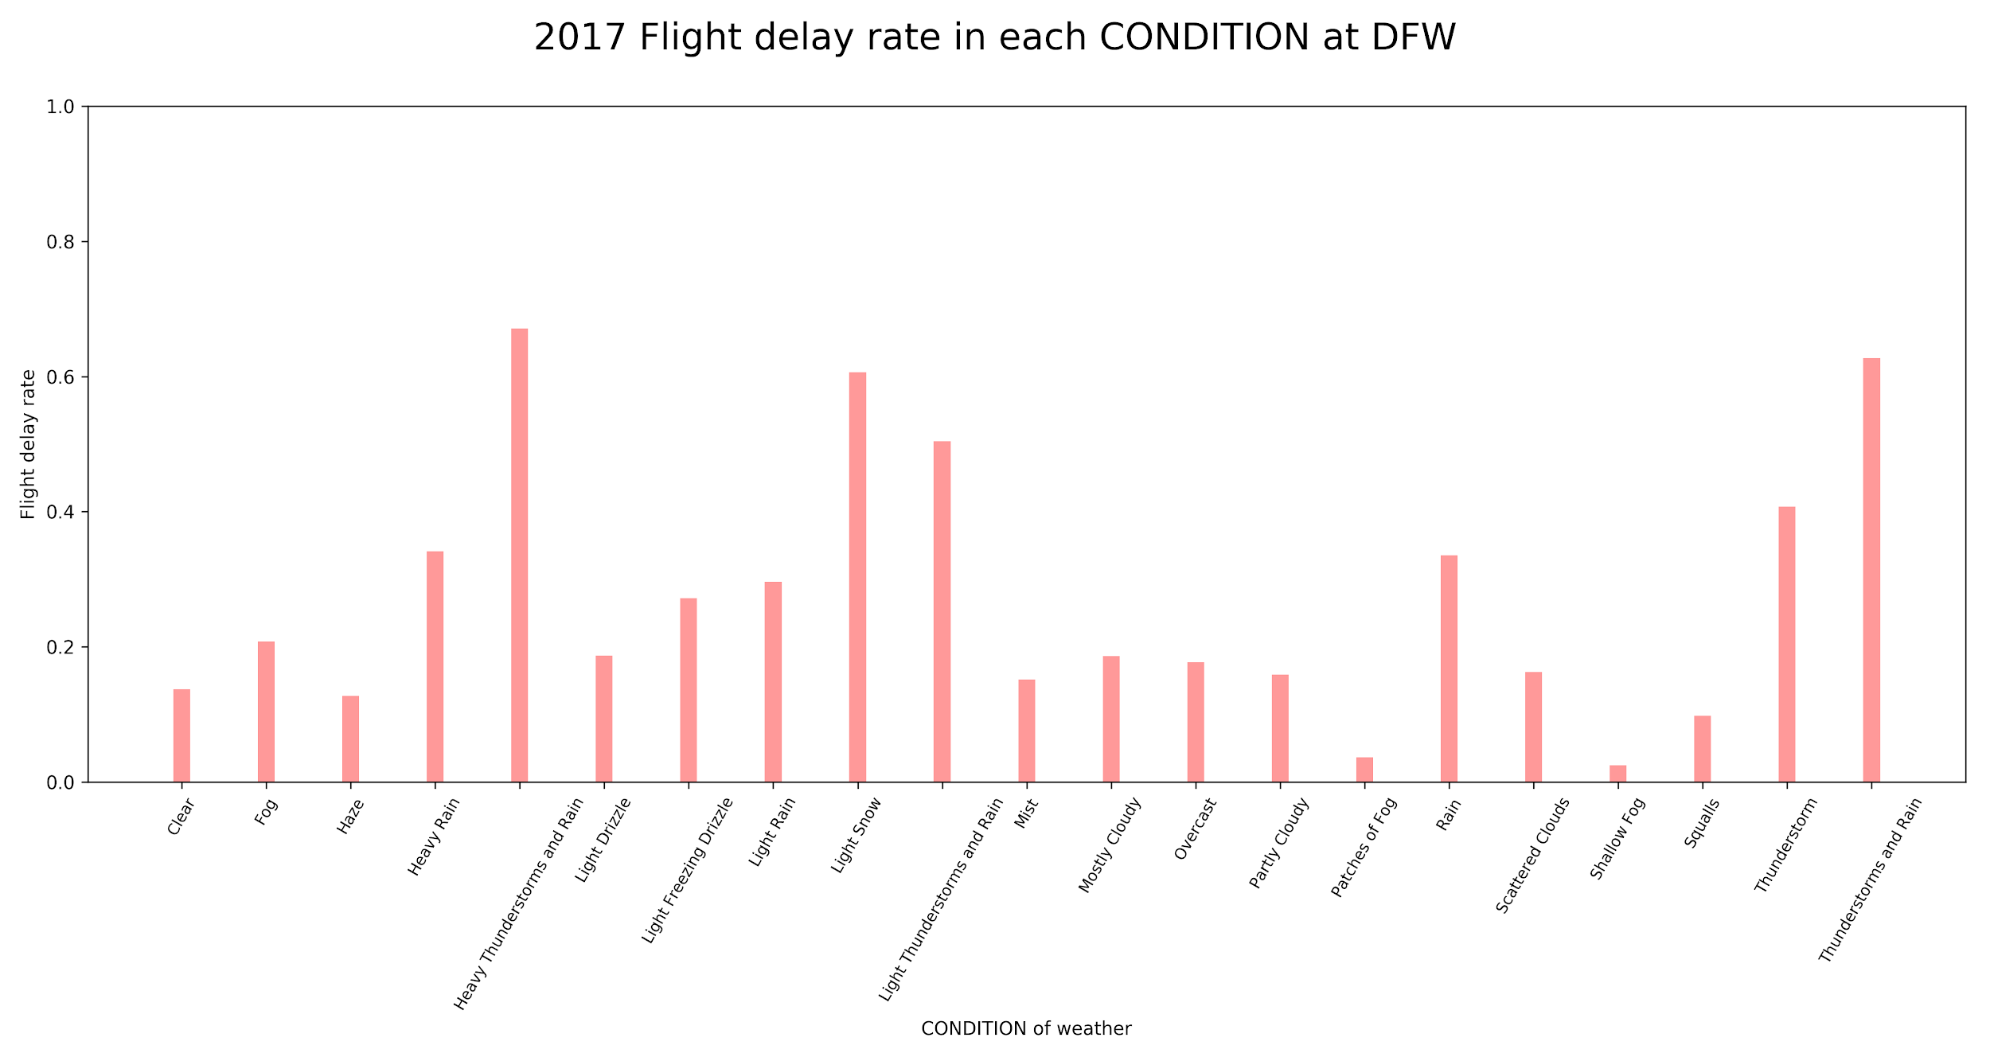
To make our analysis more robust, we look at 4 additional cities and their airports: Atlanta (Georgia), Orlando (Florida), Denver (Colorado) and Dallas (Texas).
The main difference is that worse weather conditions occur outside of California (i.g. Snowstorms, Thunderstorms.
The general relationship is the same: Worse weather means more delays
Notes:
Talk about how “weather condition” is too general of statement to segue into next slide about visibility and windspeed

Slide 16
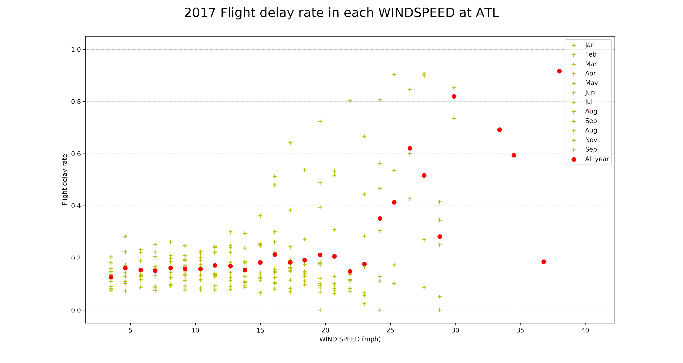
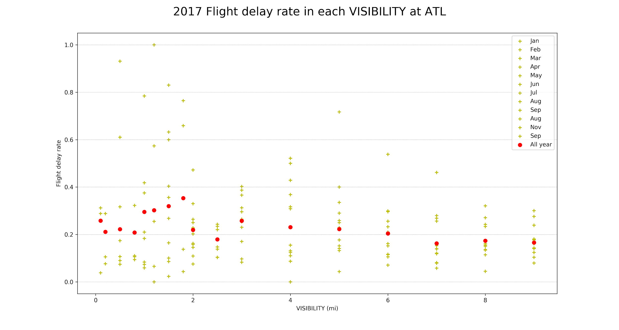
VISIBILITY/WINDSPEED VERSUS DELAY
A more useful relationship can be seen by using visibility and windspeed, here we look at Atlanta, Georgia.
We can clearly see that as wind speed increases, there are more flight delays as well.
Unexpectedly however, there is not a clear relationship between weather visibility and flight delays.

Slide 17
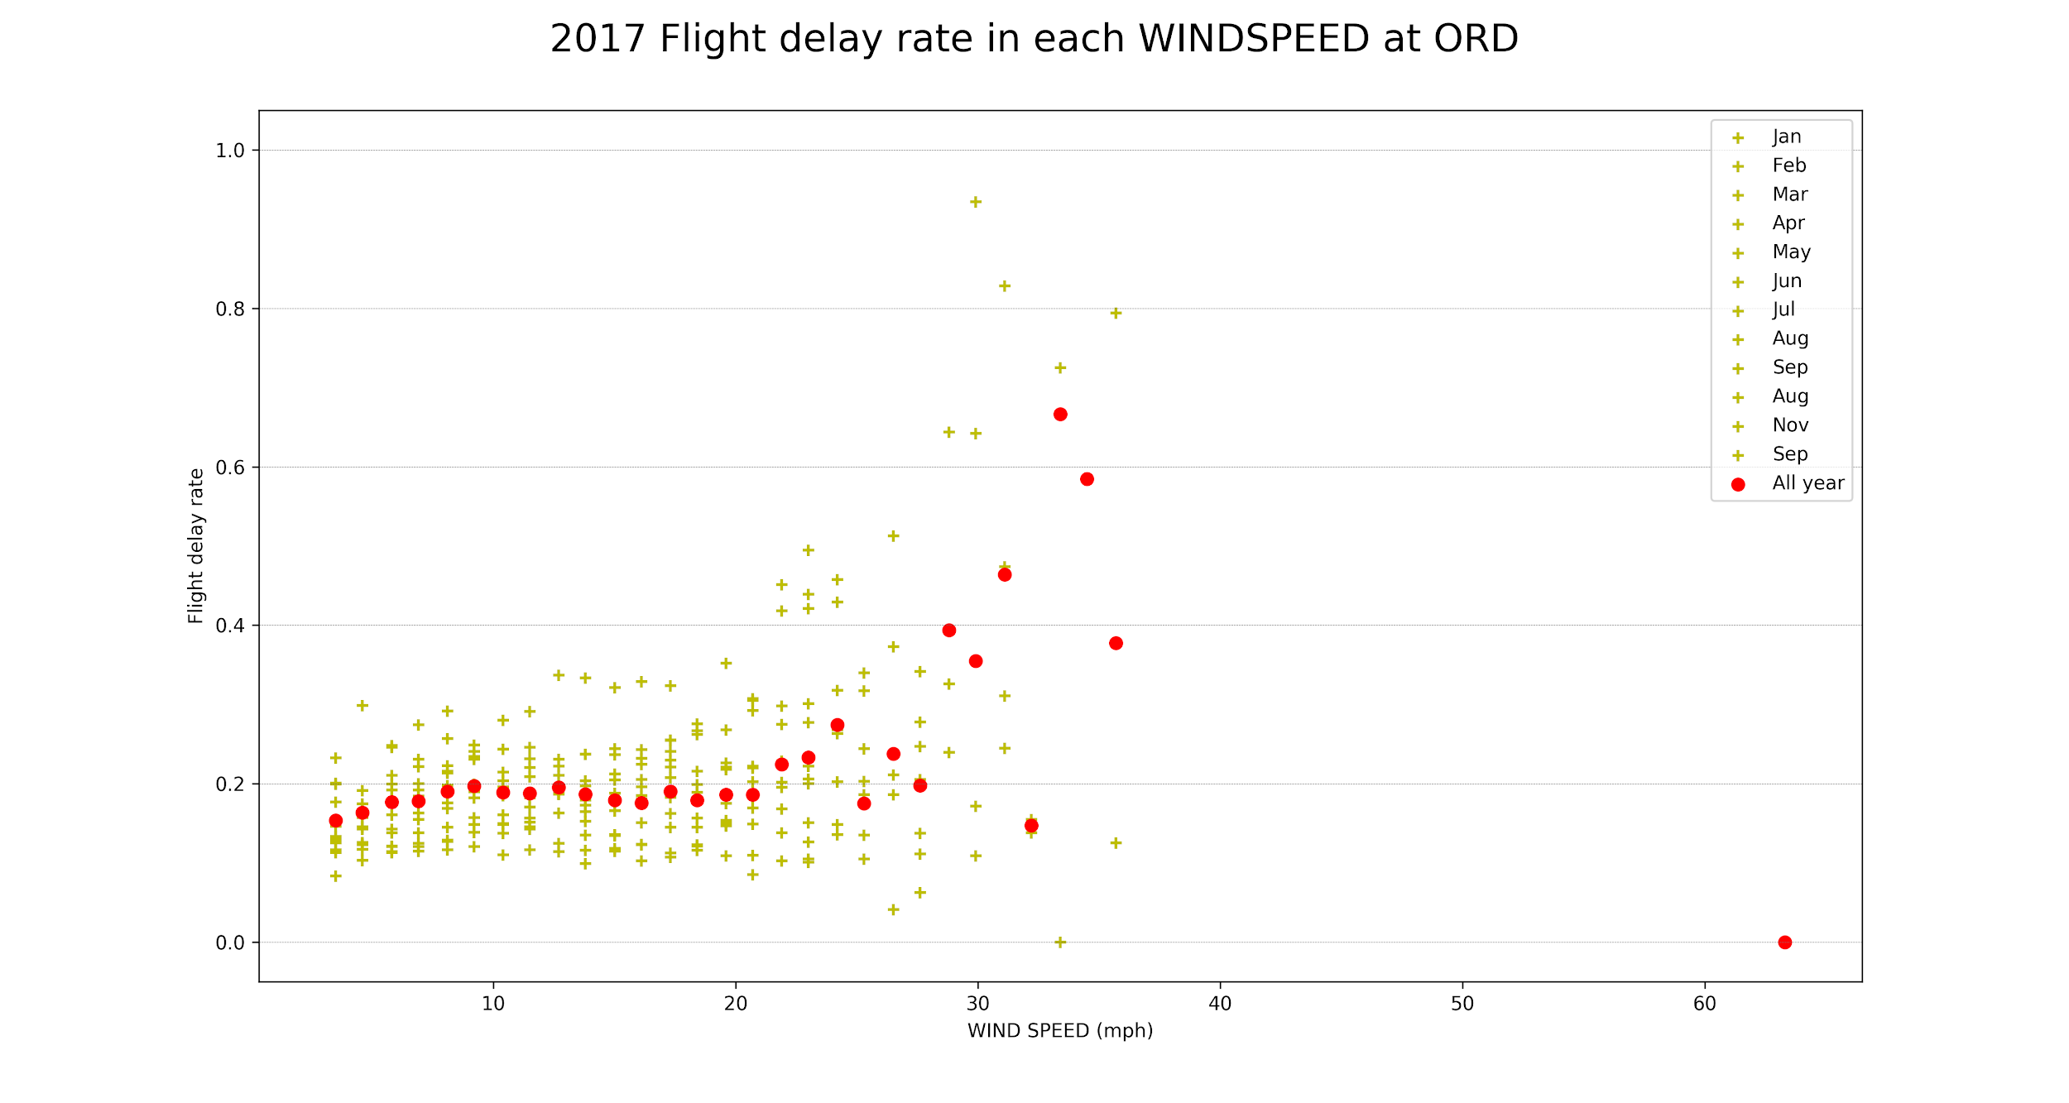
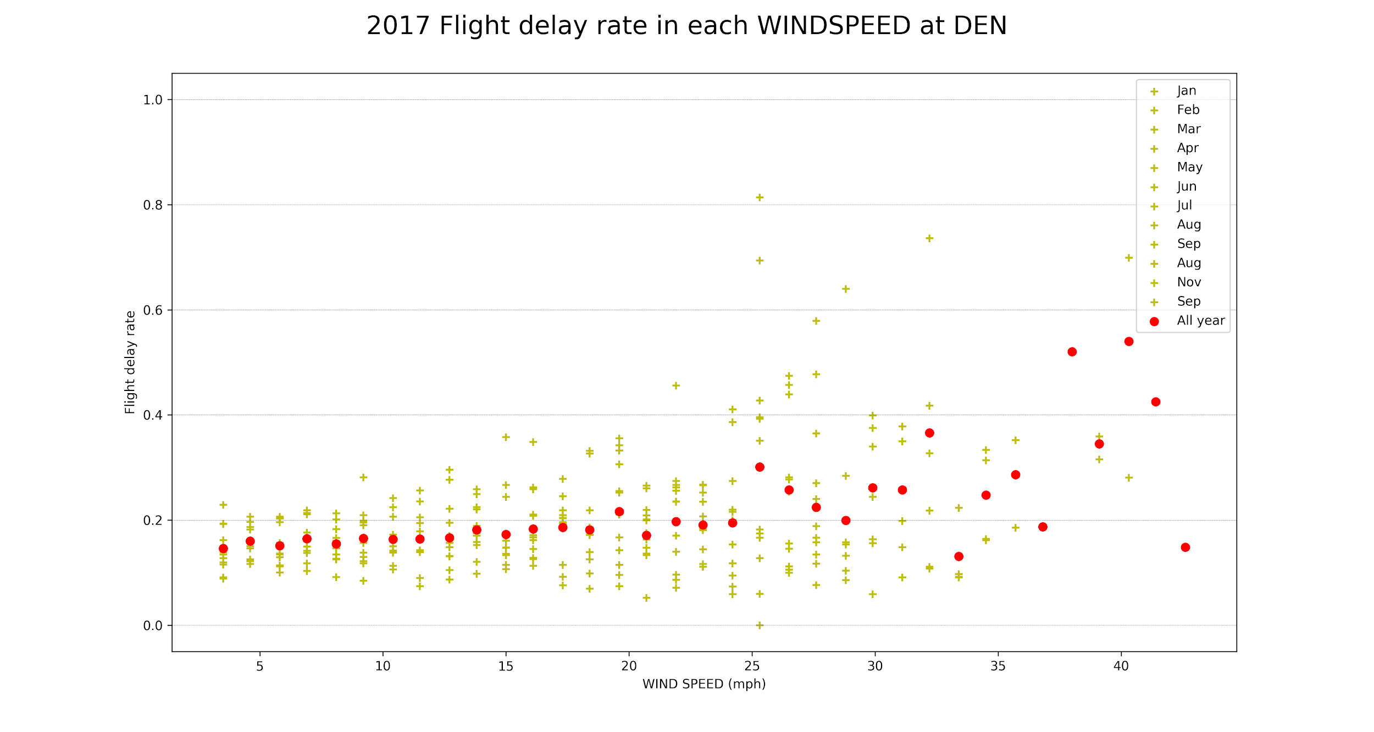
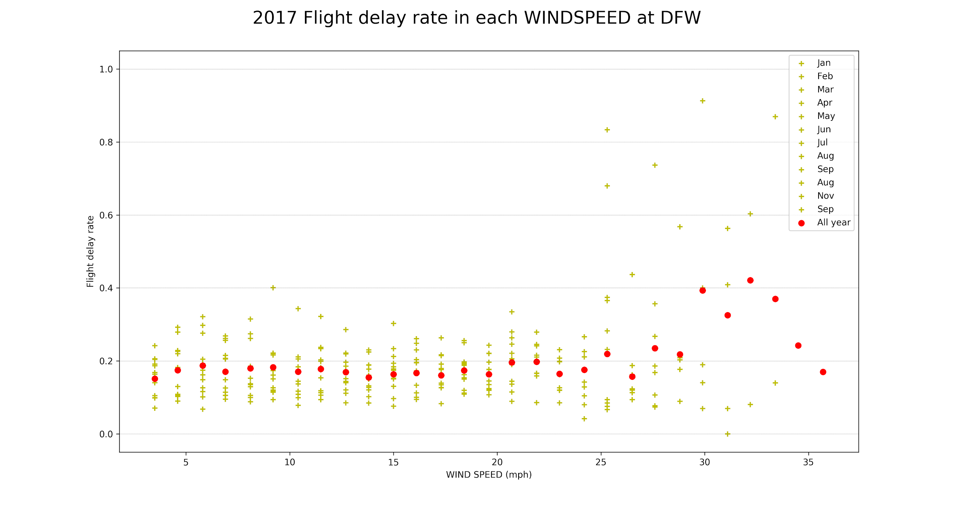
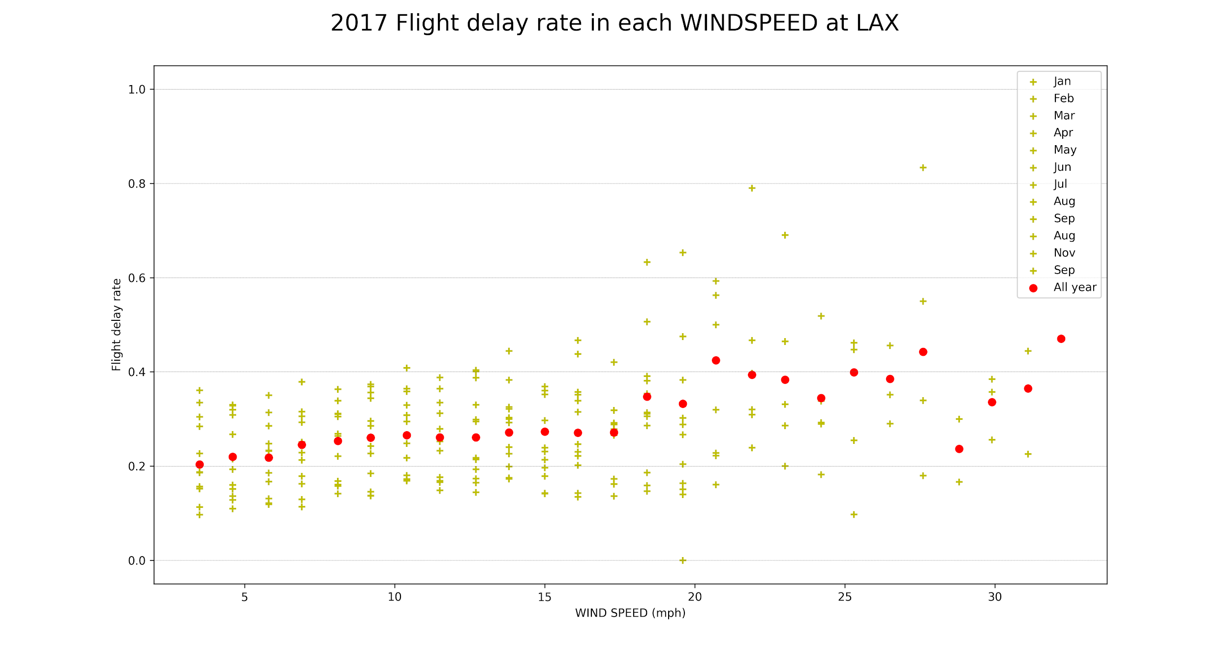
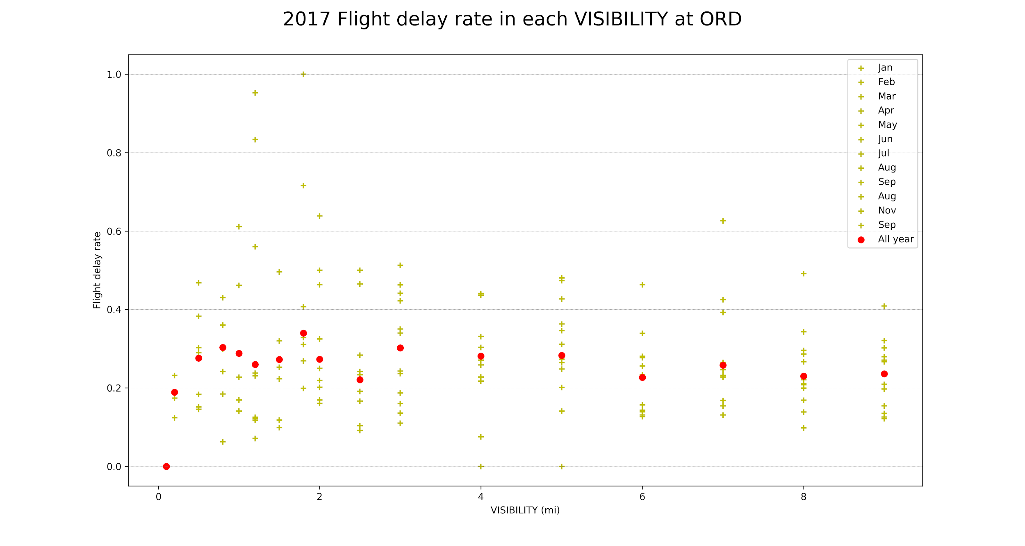
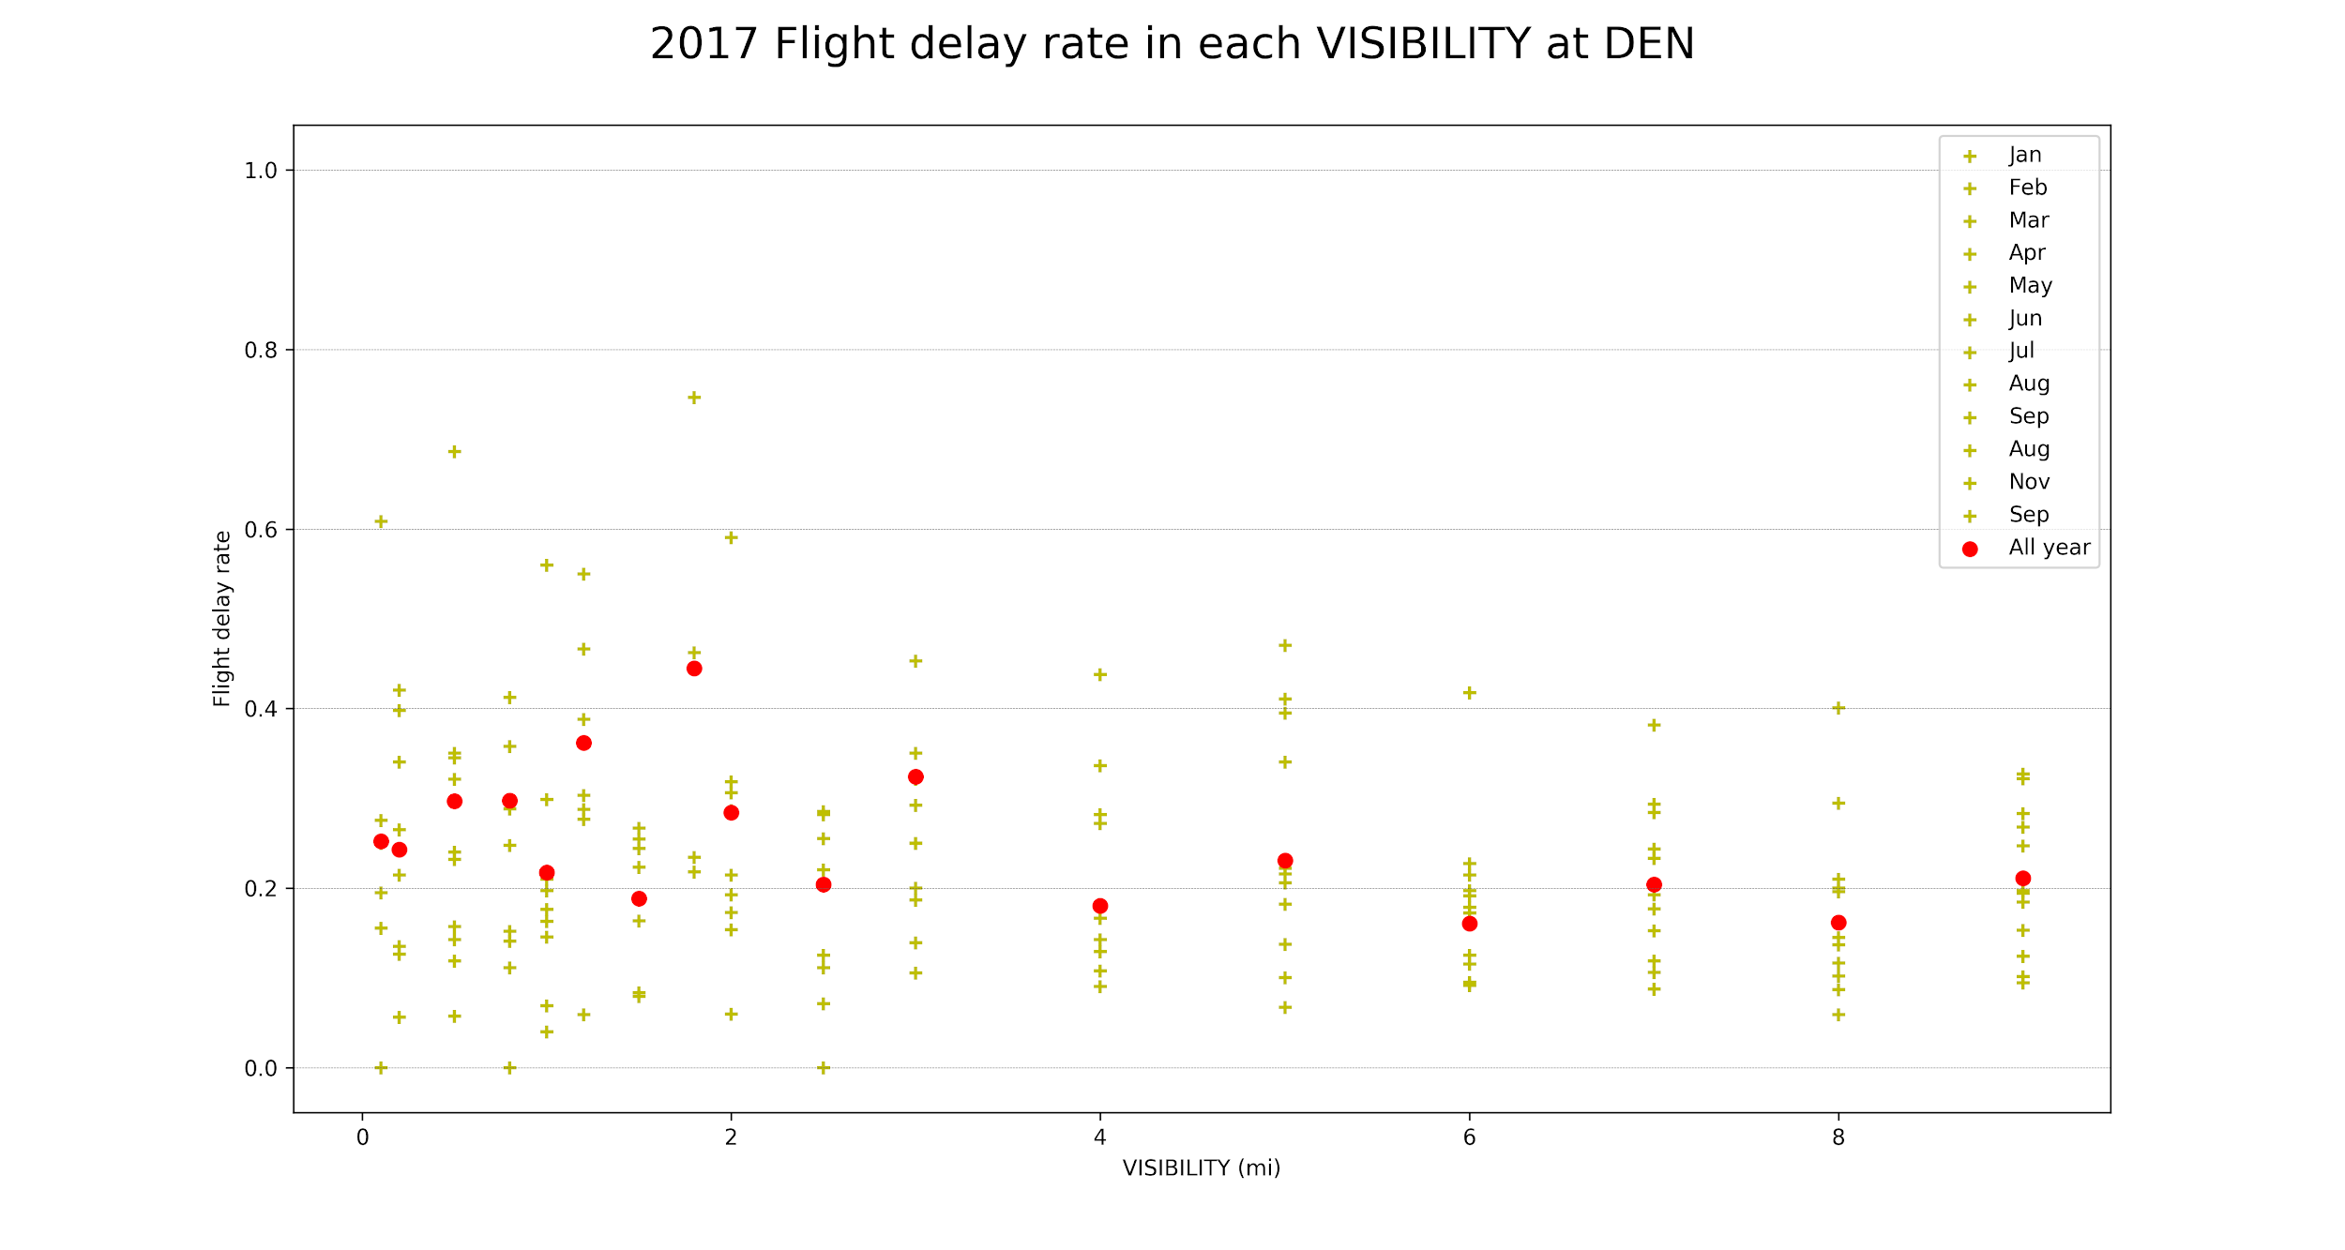
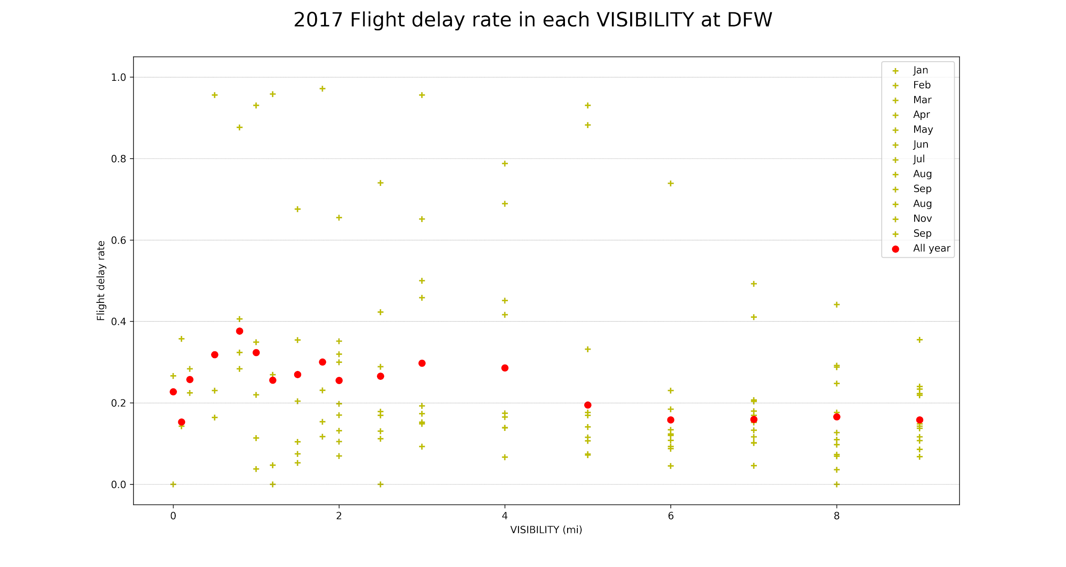
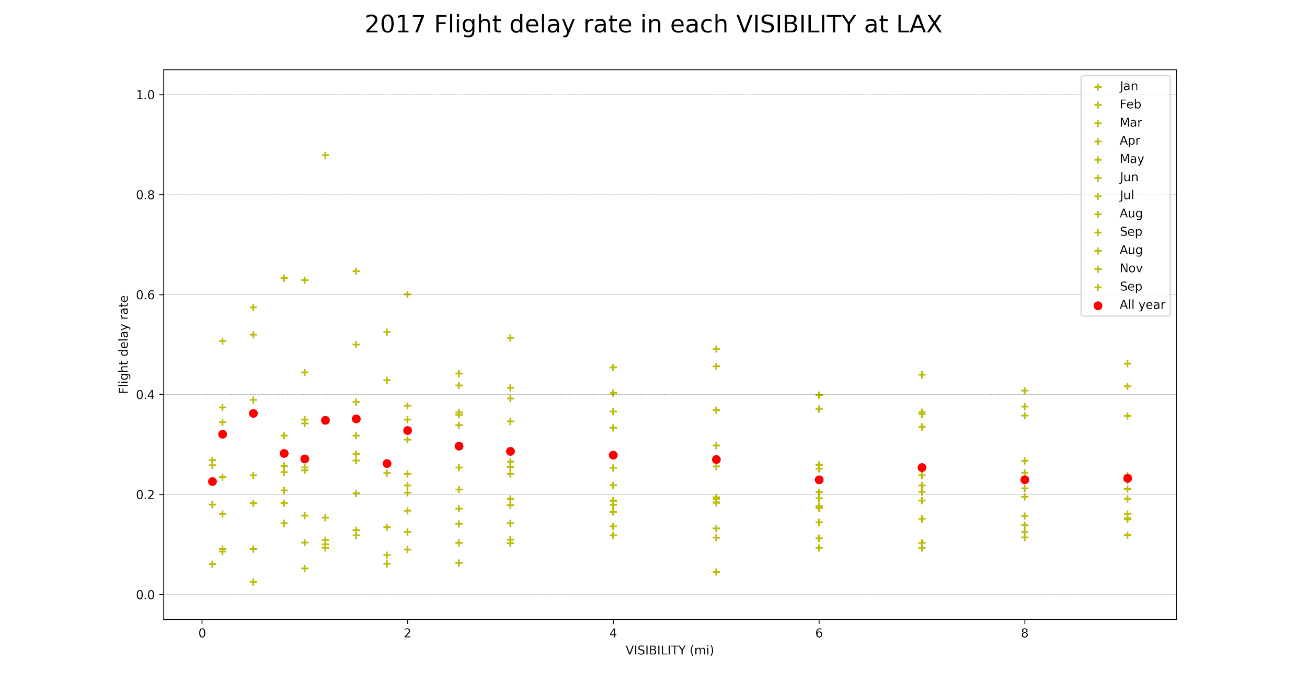
These are the windspeed and visibility plots of the 4 additional cities:: (Georgia), Orlando (Florida), Denver (Colorado), Dallas (Texas) and Los Angeles (California).
The key takeaway is that areas with less violent windspeeds overall tend to have a weaker relationship between windspeeds and delays.
This is likely due less intense weather in the respective areas.
Visibility versus delays still has no clear relationship

Slide 18
DELAY PREDICTIONS
3
Using Linear Regression
Notes:
We only look at one specific year 2017.

Slide 19
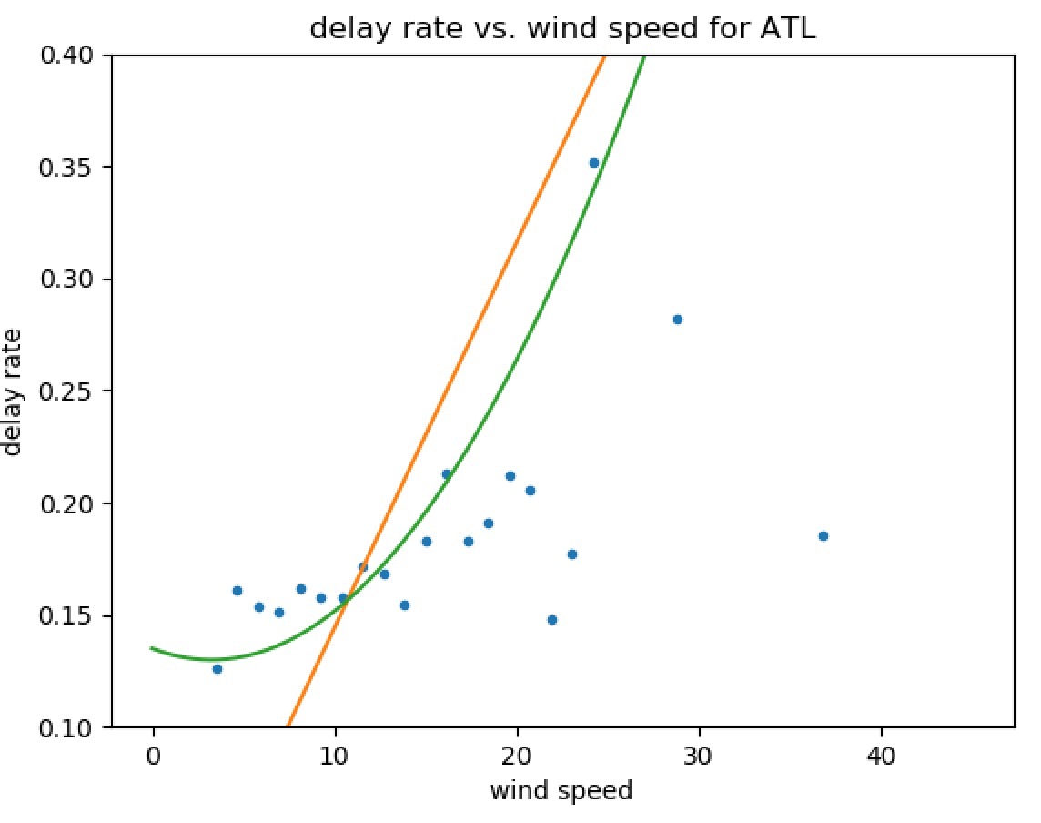
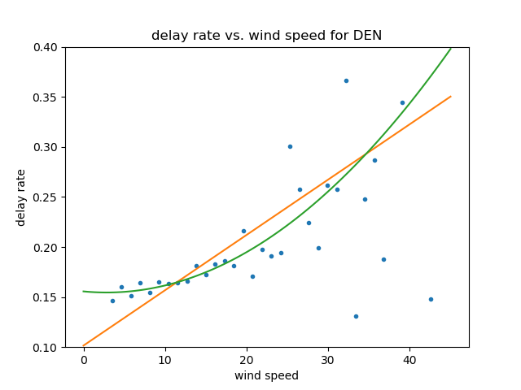
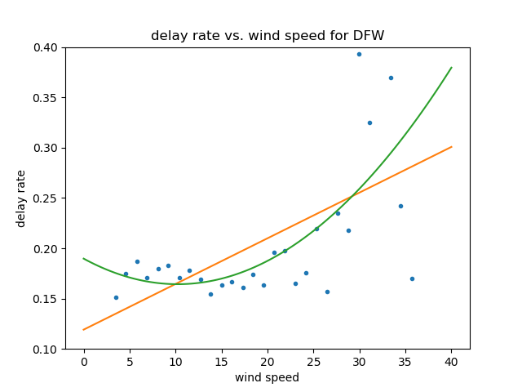
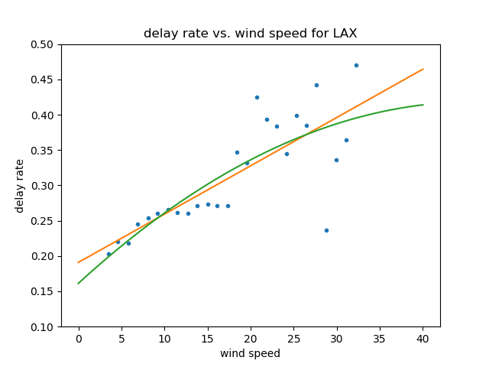
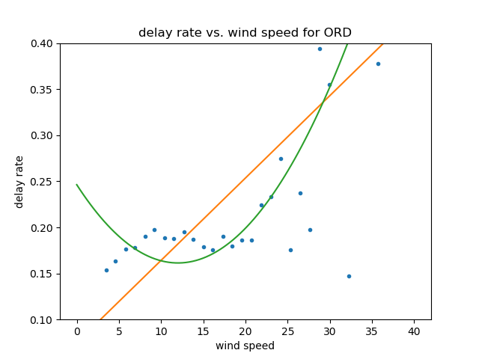
PLOTS OF RELATIONSHIP MODELS
We use Linear and Quadratic regression to establish a well defined relationship between Wind Speed(mph) and Delay Percentages

Slide 20
RELATION EQUATION (ATLANTA)
The city that we chose to do prediction on was Atlanta, Georgia.
The Quadratic model appears to be more accurate
Linear:
DELAY = 0.0172*WSPEED - 0.0279
Quadratic:
DELAY = 0.0005*WSPEED^2 - 0.031*WSPEED + 0.135.

Slide 21
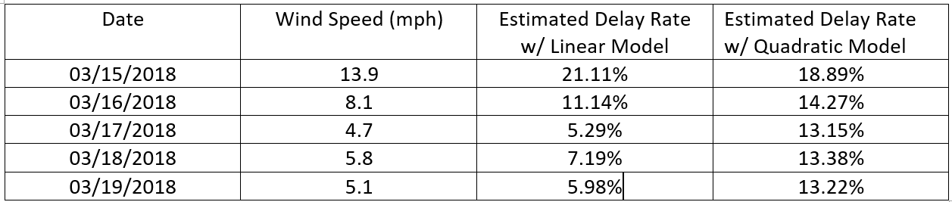
5 DAY DELAY PREDICTION
The 5 day wind speed forecast is collected from the website Willy Weather.
The model is not completely accurate because it cannot take into account the main cause delays: Air Carrier Issues.
However, it does give us an idea of when there will be a higher likelihood of flight delays.

Slide 22
CONCLUSIONS
4
What We Can Do Better
Notes:
We only look at one specific year 2017.

Slide 23
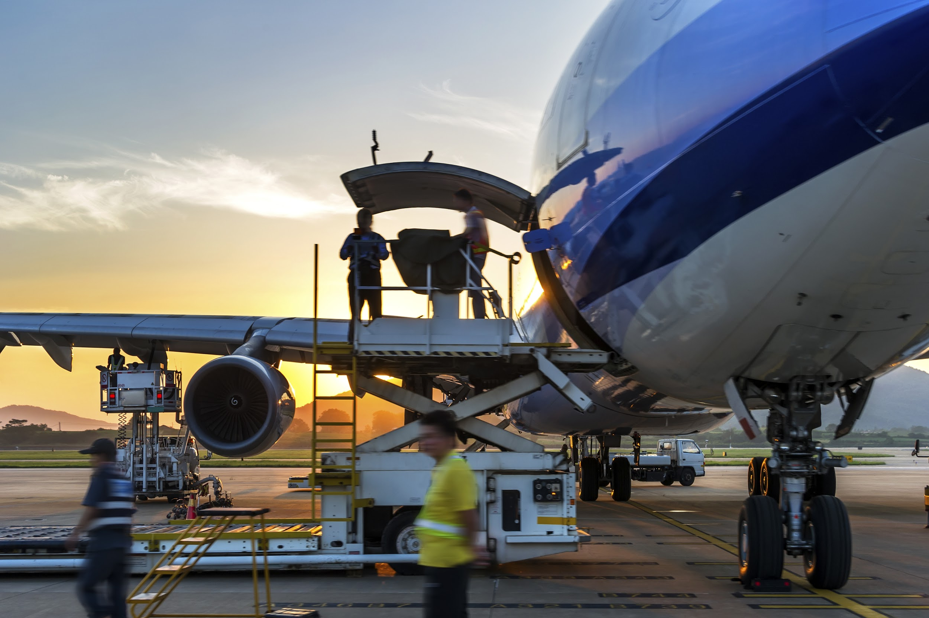
SUMMARY OF RESULTS
In regards to flight delays, the day of Friday and month of June had the highest percentage of delays while Monday and February had the lowest
We hypothesize this is due to the increased traffic in those time periods
General Air Carrier issues were the biggest cause of delays.
Maintenance, Crew scheduling etc.
Delay percentages between recent years are similar.
Notes:
Urllib2
BeautifulSoup

Slide 24
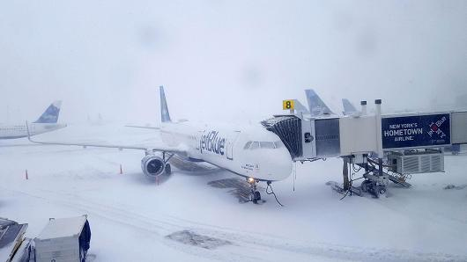
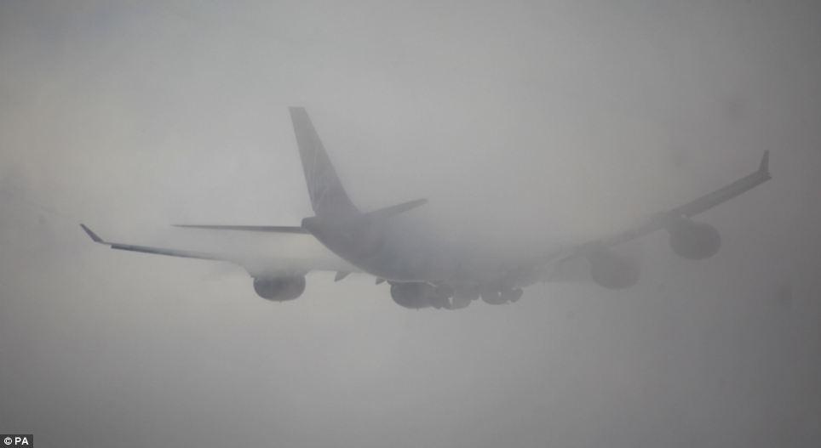
SUMMARY OF RESULTS
The worse the weather condition is on any particular day, the higher chance there is for a flight delay.
There is a clear relationship between flight delay percentages and windspeed.
Quadratic Model: DELAY = 0.0005*WSPEED^2 - 0.031* WSPEED + 0.135.
There does not appear to be a relationship between flight delay percentages and visibility.
It could be that pilots can easily navigate through fog.
Notes:
Urllib2
BeautifulSoup

Slide 25
THANK YOU FOR YOUR TIME

Slide 26
REFERENCES
Air Traffic By The Numbers: https://www.faa.gov/air_traffic/by_the_numbers/
Flight Delay Cost: https://en.wikipedia.org/wiki/Flight_cancellation_and_delay
Airplane Picture: http://atwonline.com/aircraft-orders-deliveries/delta-orders-30-airbus-a321ceos
Airplane Maintenance: http://www.aviationmaintenance.edu/blog/aircraft-maintenance/worst-aircraft-maintenance-fails-time-prevented/
Snowstorm Plane: https://www.cnbc.com/2018/01/06/blizzard-snarls-air-traffic-at-jfk-as-2-planes-collide-and-hundreds-of-flights-are-delayed.html
Fog: http://www.dailymail.co.uk/news/article-2521765/Thick-fog-brings-disruption-Britains-roads-airports.html
Wind Speed Forecast: https://wind.willyweather.com/ga/fulton-county/atlanta.html
Weather Data: https://www.wunderground.com/
Delay Data: http://www.transtats.bts.gov/AircraftDelay/mainpage.aspx?fromYr=24186&toYr=24198
Notes:
More to add

